Slide 1
Twelve
Middle School Regional
November 22, 2014
Presented By
North Carolina Association for Scholastic Activities
Twelve: State Final
Copyright © 2014. All Rights Reserved.
North Carolina Association for Scholastic Activities

Slide 2
Topic Assignments
Group A
1) Life Science
5) NC Colleges and Univ.
9) Arts / Media
Group C
3) Writing
7) US History
11) NC Government
Group B
2) World History
6) Literature
10) Earth Science
Group D
4) PE / Sports
8) Mathematics
12) Technology
Twelve: State Final
Copyright © 2014. All Rights Reserved.
North Carolina Association for Scholastic Activities
Notes:
Kick-off warning: 12 minute

Slide 3
Topic Assignments
Group A
1) Life Science
5) NC Colleges and Univ.
9) Arts / Media
Group C
3) Writing
7) US History
11) NC Government
Group B
2) World History
6) Literature
10) Earth Science
Group D
4) PE / Sports
8) Mathematics
12) Technology
9 Minutes Remaining
Twelve: State Final
Copyright © 2014. All Rights Reserved.
North Carolina Association for Scholastic Activities
Notes:
Kick-off warning: 12 minute

Slide 4
Topic Assignments
Group A
1) Life Science
5) NC Colleges and Univ.
9) Arts / Media
Group C
3) Writing
7) US History
11) NC Government
Group B
2) World History
6) Literature
10) Earth Science
Group D
4) PE / Sports
8) Mathematics
12) Technology
6 Minutes Remaining
Twelve: State Final
Copyright © 2014. All Rights Reserved.
North Carolina Association for Scholastic Activities
Notes:
Kick-off warning: 12 minute

Slide 5
Topic Assignments
Group A
1) Life Science
5) NC Colleges and Univ.
9) Arts / Media
Group C
3) Writing
7) US History
11) NC Government
Group B
2) World History
6) Literature
10) Earth Science
Group D
4) PE / Sports
8) Mathematics
12) Technology
3 Minutes Remaining
Twelve: State Final
Copyright © 2014. All Rights Reserved.
North Carolina Association for Scholastic Activities
Notes:
Kick-off warning: 12 minute

Slide 6
Topic Assignments
Group A
1) Life Science
5) NC Colleges and Univ.
9) Arts / Media
Group C
3) Writing
7) US History
11) NC Government
Group B
2) World History
6) Literature
10) Earth Science
Group D
4) PE / Sports
8) Mathematics
12) Technology
2 Minutes Remaining
Twelve: State Final
Copyright © 2014. All Rights Reserved.
North Carolina Association for Scholastic Activities
Notes:
Kick-off warning: 12 minute

Slide 7
Topic Assignments
Group A
1) Life Science
5) NC Colleges and Univ.
9) Arts / Media
Group C
3) Writing
7) US History
11) NC Government
Group B
2) World History
6) Literature
10) Earth Science
Group D
4) PE / Sports
8) Mathematics
12) Technology
1 Minute Remaining
Twelve: State Final
Copyright © 2014. All Rights Reserved.
North Carolina Association for Scholastic Activities
Notes:
Kick-off warning: 12 minute

Slide 8
Topic Assignments
Group A
1) Life Science
5) NC Colleges and Univ.
9) Arts / Media
Group C
3) Writing
7) US History
11) NC Government
Group B
2) World History
6) Literature
10) Earth Science
Group D
4) PE / Sports
8) Mathematics
12) Technology
12 Seconds Remaining
Twelve: State Final
Copyright © 2014. All Rights Reserved.
North Carolina Association for Scholastic Activities
Notes:
Kick-off warning: 12 minute

Slide 9
Round 1: Life Science
Group A Students are seated with line-up in hand.
Round 1 will begin once all line-ups are collected.
School names are on the back of all scoresheets. Do not write your school name on the front.
Twelve: State Final
Copyright © 2014. All Rights Reserved.
North Carolina Association for Scholastic Activities
Notes:
Round beginning slide

Slide 10
Round 1: Life Science
Question #1:
Bacteriophages are examples of these organisms that attack bacteria. What class of infectious agents includes hepatitis B, HIV, and smallpox?
Twelve: State Final
Copyright © 2014. All Rights Reserved.
North Carolina Association for Scholastic Activities
Notes:
Three second question slide

Slide 11
Round 1: Life Science
Question #1:
Bacteriophages are examples of these organisms that attack bacteria. What class of infectious agents includes hepatitis B, HIV, and smallpox?
Twelve: State Final
Copyright © 2014. All Rights Reserved.
North Carolina Association for Scholastic Activities
Notes:
Three second question slide

Slide 12
Round 1: Life Science
Question #2:
What is the name for the class of vertebrates that usually have hair, feed milk to their young, and give live birth?
Twelve: State Final
Copyright © 2014. All Rights Reserved.
North Carolina Association for Scholastic Activities
Notes:
Three second question slide

Slide 13
Round 1: Life Science
Question #2:
What is the name for the class of vertebrates that usually have hair, feed milk to their young, and give live birth?
Twelve: State Final
Copyright © 2014. All Rights Reserved.
North Carolina Association for Scholastic Activities
Notes:
Three second question slide

Slide 14
Round 1: Life Science
Question #3:
Mutualism, commensualism, and parasitism are examples of what type of long term relationship between two species?
Twelve: State Final
Copyright © 2014. All Rights Reserved.
North Carolina Association for Scholastic Activities
Notes:
Three second question slide

Slide 15
Round 1: Life Science
Question #3:
Mutualism, commensualism, and parasitism are examples of what type of long term relationship between two species?
Twelve: State Final
Copyright © 2014. All Rights Reserved.
North Carolina Association for Scholastic Activities
Notes:
Three second question slide

Slide 16
Round 1: Life Science
Question #4:
Emphysema and pneumonia are diseases of what paired organ which is responsible for breathing?
Twelve: State Final
Copyright © 2014. All Rights Reserved.
North Carolina Association for Scholastic Activities
Notes:
Three second question slide

Slide 17
Round 1: Life Science
Question #4:
Emphysema and pneumonia are diseases of what paired organ which is responsible for breathing?
Twelve: State Final
Copyright © 2014. All Rights Reserved.
North Carolina Association for Scholastic Activities
Notes:
Three second question slide

Slide 18
Round 1: Life Science
Question #5:
In plants, the cell wall surrounds what surface that encloses the cell?
Twelve: State Final
Copyright © 2014. All Rights Reserved.
North Carolina Association for Scholastic Activities
Notes:
Three second question slide

Slide 19
Round 1: Life Science
Question #5:
In plants, the cell wall surrounds what surface that encloses the cell?
Twelve: State Final
Copyright © 2014. All Rights Reserved.
North Carolina Association for Scholastic Activities
Notes:
Three second question slide

Slide 20
Round 1: Life Science
Question #6:
What type of aquatic plant has “red” and “blue-green” varieties? They include seaweed.
Twelve: State Final
Copyright © 2014. All Rights Reserved.
North Carolina Association for Scholastic Activities
Notes:
Three second question slide

Slide 21
Round 1: Life Science
Question #6:
What type of aquatic plant has “red” and “blue-green” varieties? They include seaweed.
Twelve: State Final
Copyright © 2014. All Rights Reserved.
North Carolina Association for Scholastic Activities
Notes:
Three second question slide

Slide 22
Round 1: Life Science
Question #7:
What observable characteristics of an organism are determined by the genotype?
Twelve: State Final
Copyright © 2014. All Rights Reserved.
North Carolina Association for Scholastic Activities
Notes:
Three second question slide

Slide 23
Round 1: Life Science
Question #7:
What observable characteristics of an organism are determined by the genotype?
Twelve: State Final
Copyright © 2014. All Rights Reserved.
North Carolina Association for Scholastic Activities
Notes:
Three second question slide

Slide 24
Round 1: Life Science
Question #8:
Finger like protrusions called villi line what organ with “small” and “large” varieties that is important in nutrient absorption?
Twelve: State Final
Copyright © 2014. All Rights Reserved.
North Carolina Association for Scholastic Activities
Notes:
Three second question slide

Slide 25
Round 1: Life Science
Question #8:
Finger like protrusions called villi line what organ with “small” and “large” varieties that is important in nutrient absorption?
Twelve: State Final
Copyright © 2014. All Rights Reserved.
North Carolina Association for Scholastic Activities
Notes:
Three second question slide

Slide 26
Round 1: Life Science
Question #9:
Bees are lured to flowers by what sweet liquid produced by flowers that is the source of sugar for honey?
Twelve: State Final
Copyright © 2014. All Rights Reserved.
North Carolina Association for Scholastic Activities
Notes:
Three second question slide

Slide 27
Round 1: Life Science
Question #9:
Bees are lured to flowers by what sweet liquid produced by flowers that is the source of sugar for honey?
Twelve: State Final
Copyright © 2014. All Rights Reserved.
North Carolina Association for Scholastic Activities
Notes:
Three second question slide

Slide 28
Round 1: Life Science
Question #10:
What biological classification lies in between kingdom and class? In the kingdom animalia, examples of this group are chordata, arthropoda, and cnidaria.
Twelve: State Final
Copyright © 2014. All Rights Reserved.
North Carolina Association for Scholastic Activities
Notes:
Three second question slide

Slide 29
Round 1: Life Science
Question #10:
What biological classification lies in between kingdom and class? In the kingdom animalia, examples of this group are chordata, arthropoda, and cnidaria.
Twelve: State Final
Copyright © 2014. All Rights Reserved.
North Carolina Association for Scholastic Activities
Notes:
Three second question slide

Slide 30
Round 1: Life Science
Question #11:
The Kakum National Park in Ghana and the Amazon are notable examples of what biome characterized by thick vegetation, high species diversity, and high levels of rainfall?
Twelve: State Final
Copyright © 2014. All Rights Reserved.
North Carolina Association for Scholastic Activities
Notes:
Three second question slide

Slide 31
Round 1: Life Science
Question #11:
The Kakum National Park in Ghana and the Amazon are notable examples of what biome characterized by thick vegetation, high species diversity, and high levels of rainfall?
Twelve: State Final
Copyright © 2014. All Rights Reserved.
North Carolina Association for Scholastic Activities
Notes:
Three second question slide

Slide 32
Round 1: Life Science
Question #12:
Females have two of what chromosome which males generally only have one of?
Twelve: State Final
Copyright © 2014. All Rights Reserved.
North Carolina Association for Scholastic Activities
Notes:
Three second question slide

Slide 33
Round 1: Life Science
Question #12:
Females have two of what chromosome which males generally only have one of?
Twelve: State Final
Copyright © 2014. All Rights Reserved.
North Carolina Association for Scholastic Activities
Notes:
Three second question slide

Slide 34
Round 1: Life Science
Students have 3 minutes to complete their answer sheets.
Twelve: State Final
Copyright © 2014. All Rights Reserved.
North Carolina Association for Scholastic Activities
Notes:
Answer sheet warnings

Slide 35
Round 1: Life Science
Students have 3 minutes to complete their answer sheets.
2 Minutes Remaining
Twelve: State Final
Copyright © 2014. All Rights Reserved.
North Carolina Association for Scholastic Activities
Notes:
Answer sheet warning: 2 minutes

Slide 36
Round 1: Life Science
Students have 3 minutes to complete their answer sheets.
1 Minute Remaining
Twelve: State Final
Copyright © 2014. All Rights Reserved.
North Carolina Association for Scholastic Activities
Notes:
Answer sheet warning: 1 minute

Slide 37
Round 1: Life Science
Students have 3 minutes to complete their answer sheets.
12 Seconds Remaining
Twelve: State Final
Copyright © 2014. All Rights Reserved.
North Carolina Association for Scholastic Activities
Notes:
Answer sheet warning: 12 seconds

Slide 38
Round 1: Life Science
TIME
Pencils Down.
Answer sheets will now be collected.
Twelve: State Final
Copyright © 2014. All Rights Reserved.
North Carolina Association for Scholastic Activities
Notes:
Answer sheet: time

Slide 39
Round 1: Life Science
Answers for Life Science questions follow on next slide.
Advance once all answer sheets have been collected.
Group A Students may return to their team.
Group B Students may be seated.
Twelve: State Final
Copyright © 2014. All Rights Reserved.
North Carolina Association for Scholastic Activities
Notes:
Prep for answers

Slide 40
Round 1: Life Science
Answers
Viruses
Mammal
Symbiosis
Lungs
Cell Membrane [or Plasma Membrane]
Algae
Phenotypes
Intestine [accept Small Intestine or Large Intestine]
Nectar
Phylum
Tropical Rainforest
X chromosome
Twelve: State Final
Copyright © 2014. All Rights Reserved.
North Carolina Association for Scholastic Activities
Notes:
Answers

Slide 41
Round 2: World History
Group B Students are seated and ready to begin.
Twelve: State Final
Copyright © 2014. All Rights Reserved.
North Carolina Association for Scholastic Activities
Notes:
Seated and ready to go

Slide 42
Round 2: World History
Question #1:
The title “Empress of India” was given to what longest reigning monarch of England whose namesake period spanned most of the late 1800s?
3s
Twelve: State Final
Copyright © 2014. All Rights Reserved.
North Carolina Association for Scholastic Activities
Notes:
Three second question slide

Slide 43
Round 2: World History
Question #1:
The title “Empress of India” was given to what longest reigning monarch of England whose namesake period spanned most of the late 1800s?
3s
Twelve: State Final
Copyright © 2014. All Rights Reserved.
North Carolina Association for Scholastic Activities
Notes:
Three second question slide

Slide 44
Round 2: World History
Question #2:
Ferdinand and Isabella, the rulers of Aragon and Castile, unified what modern day country?
3s
Twelve: State Final
Copyright © 2014. All Rights Reserved.
North Carolina Association for Scholastic Activities
Notes:
Three second question slide

Slide 45
Round 2: World History
Question #2:
Ferdinand and Isabella, the rulers of Aragon and Castile, unified what modern day country?
3s
Twelve: State Final
Copyright © 2014. All Rights Reserved.
North Carolina Association for Scholastic Activities
Notes:
Three second question slide

Slide 46
Round 2: World History
Question #3:
In 2009, Hermann de Rompuy became the first president of what organization with capital at Brussels that unites the countries on its namesake continent?
3s
Twelve: State Final
Copyright © 2014. All Rights Reserved.
North Carolina Association for Scholastic Activities
Notes:
Three second question slide

Slide 47
Round 2: World History
Question #3:
In 2009, Hermann de Rompuy became the first president of what organization with capital at Brussels that unites the countries on its namesake continent?
3s
Twelve: State Final
Copyright © 2014. All Rights Reserved.
North Carolina Association for Scholastic Activities
Notes:
Three second question slide

Slide 48
Round 2: World History
What author of the “Little Red Book” was the first Communist ruler of China?
Question #4:
What explorer who sought to reach the Spice Islands by traveling west died after a clash in the Philippines? He led the first expedition to circumnavigate the world.
3s
Twelve: State Final
Copyright © 2014. All Rights Reserved.
North Carolina Association for Scholastic Activities
Notes:
Three second question slide

Slide 49
Round 2: World History
What author of the “Little Red Book” was the first Communist ruler of China?
Question #4:
What explorer who sought to reach the Spice Islands by traveling west died after a clash in the Philippines? He led the first expedition to circumnavigate the world.
3s
Twelve: State Final
Copyright © 2014. All Rights Reserved.
North Carolina Association for Scholastic Activities
Notes:
Three second question slide

Slide 50
Round 2: World History
Question #5:
What Frankish ruler who had his capital at Aachen was crowned the first Holy Roman Emperor by Leo III in 800?
3s
Twelve: State Final
Copyright © 2014. All Rights Reserved.
North Carolina Association for Scholastic Activities
Notes:
Three second question slide

Slide 51
Round 2: World History
Question #5:
What Frankish ruler who had his capital at Aachen was crowned the first Holy Roman Emperor by Leo III in 800?
3s
Twelve: State Final
Copyright © 2014. All Rights Reserved.
North Carolina Association for Scholastic Activities
Notes:
Three second question slide

Slide 52
Round 2: World History
Question #6:
What largest of the Nazi concentration camps had subcamps at Birkenau and Monowitz.
3s
Twelve: State Final
Copyright © 2014. All Rights Reserved.
North Carolina Association for Scholastic Activities
Notes:
Three second question slide

Slide 53
Round 2: World History
Question #6:
What largest of the Nazi concentration camps had subcamps at Birkenau and Monowitz.
3s
Twelve: State Final
Copyright © 2014. All Rights Reserved.
North Carolina Association for Scholastic Activities
Notes:
Three second question slide

Slide 54
Round 2: World History
Question #7:
The Pax Romana began under what first Roman emperor who was the adopted son of Julius Caesar?
3s
Twelve: State Final
Copyright © 2014. All Rights Reserved.
North Carolina Association for Scholastic Activities
Notes:
Three second question slide

Slide 55
Round 2: World History
Question #7:
The Pax Romana began under what first Roman emperor who was the adopted son of Julius Caesar?
3s
Twelve: State Final
Copyright © 2014. All Rights Reserved.
North Carolina Association for Scholastic Activities
Notes:
Three second question slide

Slide 56
Round 2: World History
Question #8:
What Hindu leader of the Indian independence movement practiced ahimsa and satyagraha in advocating nonviolence?
3s
Twelve: State Final
Copyright © 2014. All Rights Reserved.
North Carolina Association for Scholastic Activities
Notes:
Three second question slide

Slide 57
Round 2: World History
Question #8:
What Hindu leader of the Indian independence movement practiced ahimsa and satyagraha in advocating nonviolence?
3s
Twelve: State Final
Copyright © 2014. All Rights Reserved.
North Carolina Association for Scholastic Activities
Notes:
Three second question slide

Slide 58
Round 2: World History
Question #9:
Kublai was the grandson of what great khan who unified the Mongols?
3s
Twelve: State Final
Copyright © 2014. All Rights Reserved.
North Carolina Association for Scholastic Activities
Notes:
Three second question slide

Slide 59
Round 2: World History
Question #9:
Kublai was the grandson of what great khan who unified the Mongols?
3s
Twelve: State Final
Copyright © 2014. All Rights Reserved.
North Carolina Association for Scholastic Activities
Notes:
Three second question slide

Slide 60
Round 2: World History
Question #10:
Much of the sugar traded in the Triangular Exchange came from what island which would later be led by the Castro brothers?
3s
Twelve: State Final
Copyright © 2014. All Rights Reserved.
North Carolina Association for Scholastic Activities
Notes:
Three second question slide

Slide 61
Round 2: World History
Question #10:
Much of the sugar traded in the Triangular Exchange came from what island which would later be led by the Castro brothers?
3s
Twelve: State Final
Copyright © 2014. All Rights Reserved.
North Carolina Association for Scholastic Activities
Notes:
Three second question slide

Slide 62
Round 2: World History
Question #11:
What Andean empire was toppled by Spanish conquistadors led by Francisco Pizarro?
3s
Twelve: State Final
Copyright © 2014. All Rights Reserved.
North Carolina Association for Scholastic Activities
Notes:
Three second question slide

Slide 63
Round 2: World History
Question #11:
What Andean empire was toppled by Spanish conquistadors led by Francisco Pizarro?
3s
Twelve: State Final
Copyright © 2014. All Rights Reserved.
North Carolina Association for Scholastic Activities
Notes:
Three second question slide

Slide 64
Round 2: World History
Question #12:
Mansa Musa led what empire with capital at Timbuktu? In 2013, French forces intervened against Islamist fighters in a country with the same name as that empire and in the same place.
3s
Twelve: State Final
Copyright © 2014. All Rights Reserved.
North Carolina Association for Scholastic Activities
Notes:
Three second question slide

Slide 65
Round 2: World History
Question #12:
Mansa Musa led what empire with capital at Timbuktu? In 2013, French forces intervened against Islamist fighters in a country with the same name as that empire and in the same place.
3s
Twelve: State Final
Copyright © 2014. All Rights Reserved.
North Carolina Association for Scholastic Activities
Notes:
Three second question slide

Slide 66
Round 2: World History
Students have 3 minutes to complete their answer sheets.
Twelve: State Final
Copyright © 2014. All Rights Reserved.
North Carolina Association for Scholastic Activities
Notes:
Answer sheet warnings

Slide 67
Round 2: World History
Students have 3 minutes to complete their answer sheets.
2 Minutes Remaining
Twelve: State Final
Copyright © 2014. All Rights Reserved.
North Carolina Association for Scholastic Activities
Notes:
Answer sheet warning: 2 minutes

Slide 68
Round 2: World History
Students have 3 minutes to complete their answer sheets.
1 Minute Remaining
Twelve: State Final
Copyright © 2014. All Rights Reserved.
North Carolina Association for Scholastic Activities
Notes:
Answer sheet warning: 1 minute

Slide 69
Round 2: World History
Students have 3 minutes to complete their answer sheets.
12 Seconds Remaining
Twelve: State Final
Copyright © 2014. All Rights Reserved.
North Carolina Association for Scholastic Activities
Notes:
Answer sheet warning: 12 seconds

Slide 70
Round 2: World History
TIME
Pencils Down.
Answer sheets will now be collected.
Twelve: State Final
Copyright © 2014. All Rights Reserved.
North Carolina Association for Scholastic Activities
Notes:
Answer sheet: time

Slide 71
Round 2: World History
Answers for World History questions follow on next slide.
Advance once all answer sheets have been collected.
Group B Students may return to their team.
Group C Students may be seated.
Twelve: State Final
Copyright © 2014. All Rights Reserved.
North Carolina Association for Scholastic Activities
Notes:
Prep for answers

Slide 72
Round 2: World History
Answers
Queen Victoria
Kingdom of Spain [or Reino de España]
European Union [or EU]
Ferdinand Magellan
Charlemagne [or Charles the Great or Carolus Magnus or Karl der Grose]
Auschwitz
Gaius Julius Caesar Augustus [or Gaius Octavius Thurinus; or Octavian; do not accept “Julius Caesar”]
Mohandas Karamchand Gandhi [or Mahatma Gandhi, or Bapu Gandhi]
Genghis Khan [or Chinghis Khan; or Temujin]
Cuba
Inca Empire [or Inka Empire]
Mali
Twelve: State Final
Copyright © 2014. All Rights Reserved.
North Carolina Association for Scholastic Activities
Notes:
Answers

Slide 73
Round 3: Writing
Group C Students are seated and ready to begin.
Twelve: State Final
Copyright © 2014. All Rights Reserved.
North Carolina Association for Scholastic Activities
Notes:
Seated and ready to go

Slide 74
Round 3: Writing
Question #1:
What literary term refers to the repetition of consonant sounds?
3s
Twelve: State Final
Copyright © 2014. All Rights Reserved.
North Carolina Association for Scholastic Activities
Notes:
Three second question slide

Slide 75
Round 3: Writing
Question #1:
What literary term refers to the repetition of consonant sounds?
3s
Twelve: State Final
Copyright © 2014. All Rights Reserved.
North Carolina Association for Scholastic Activities
Notes:
Three second question slide

Slide 76
Round 3: Writing
What words modify nouns and noun phrases?
Question #2:
What is the term for a verb used as a noun by putting “ing” at the end? An example is the word “Walking” in the phrase “Walking is fun.”
3s
Twelve: State Final
Copyright © 2014. All Rights Reserved.
North Carolina Association for Scholastic Activities
Notes:
Three second question slide

Slide 77
Round 3: Writing
What words modify nouns and noun phrases?
Question #2:
What is the term for a verb used as a noun by putting “ing” at the end? An example is the word “Walking” in the phrase “Walking is fun.”
3s
Twelve: State Final
Copyright © 2014. All Rights Reserved.
North Carolina Association for Scholastic Activities
Notes:
Three second question slide

Slide 78
Round 3: Writing
Question #3:
What term refers to a thought expressed in poetry as a pair of rhyming lines?
3s
Twelve: State Final
Copyright © 2014. All Rights Reserved.
North Carolina Association for Scholastic Activities
Notes:
Three second question slide

Slide 79
Round 3: Writing
Question #3:
What term refers to a thought expressed in poetry as a pair of rhyming lines?
3s
Twelve: State Final
Copyright © 2014. All Rights Reserved.
North Carolina Association for Scholastic Activities
Notes:
Three second question slide

Slide 80
Round 3: Writing
Question #4:
What part of speech refers to a person, place, or thing? These parts of speech can be subjects or objects.
3s
Twelve: State Final
Copyright © 2014. All Rights Reserved.
North Carolina Association for Scholastic Activities
Notes:
Three second question slide

Slide 81
Round 3: Writing
Question #4:
What part of speech refers to a person, place, or thing? These parts of speech can be subjects or objects.
3s
Twelve: State Final
Copyright © 2014. All Rights Reserved.
North Carolina Association for Scholastic Activities
Notes:
Three second question slide

Slide 82
Round 3: Writing
Question #5:
What literary term refers to a long speech in a play where a character expresses his feelings, often to another character? This is different from a soliloquy or aside.
3s
Twelve: State Final
Copyright © 2014. All Rights Reserved.
North Carolina Association for Scholastic Activities
Notes:
Three second question slide

Slide 83
Round 3: Writing
Question #5:
What literary term refers to a long speech in a play where a character expresses his feelings, often to another character? This is different from a soliloquy or aside.
3s
Twelve: State Final
Copyright © 2014. All Rights Reserved.
North Carolina Association for Scholastic Activities
Notes:
Three second question slide

Slide 84
Round 3: Writing
Question #6:
What grammatical term refers to when something happens? In English, these include “past,” “present,” and “past perfect.”
3s
Twelve: State Final
Copyright © 2014. All Rights Reserved.
North Carolina Association for Scholastic Activities
Notes:
Three second question slide

Slide 85
Round 3: Writing
Question #6:
What grammatical term refers to when something happens? In English, these include “past,” “present,” and “past perfect.”
3s
Twelve: State Final
Copyright © 2014. All Rights Reserved.
North Carolina Association for Scholastic Activities
Notes:
Three second question slide

Slide 86
Round 3: Writing
Question #7:
What is the term for a part of a story in which something from the past is portrayed? For example, in a movie, this could refer to a scene from a character’s childhood that interrupts a scene set in the present.
3s
Twelve: State Final
Copyright © 2014. All Rights Reserved.
North Carolina Association for Scholastic Activities
Notes:
Three second question slide

Slide 87
Round 3: Writing
Question #7:
What is the term for a part of a story in which something from the past is portrayed? For example, in a movie, this could refer to a scene from a character’s childhood that interrupts a scene set in the present.
3s
Twelve: State Final
Copyright © 2014. All Rights Reserved.
North Carolina Association for Scholastic Activities
Notes:
Three second question slide

Slide 88
Round 3: Writing
Question #8:
What term refers to a reference book that lets people look up words that mean the same as other words?
3s
Twelve: State Final
Copyright © 2014. All Rights Reserved.
North Carolina Association for Scholastic Activities
Notes:
Three second question slide

Slide 89
Round 3: Writing
Question #8:
What term refers to a reference book that lets people look up words that mean the same as other words?
3s
Twelve: State Final
Copyright © 2014. All Rights Reserved.
North Carolina Association for Scholastic Activities
Notes:
Three second question slide

Slide 90
Round 3: Writing
Question #9:
What five letter word refers to a category of literature or art? In describing novels, examples of such categories include romance, mystery, and science fiction.
3s
Twelve: State Final
Copyright © 2014. All Rights Reserved.
North Carolina Association for Scholastic Activities
Notes:
Three second question slide

Slide 91
Round 3: Writing
Question #9:
What five letter word refers to a category of literature or art? In describing novels, examples of such categories include romance, mystery, and science fiction.
3s
Twelve: State Final
Copyright © 2014. All Rights Reserved.
North Carolina Association for Scholastic Activities
Notes:
Three second question slide

Slide 92
Round 3: Writing
Question #10:
What is the term for a term created by putting the first letters of several words together? An example is USA for United States of America.
3s
Twelve: State Final
Copyright © 2014. All Rights Reserved.
North Carolina Association for Scholastic Activities
Notes:
Three second question slide

Slide 93
Round 3: Writing
Question #10:
What is the term for a term created by putting the first letters of several words together? An example is USA for United States of America.
3s
Twelve: State Final
Copyright © 2014. All Rights Reserved.
North Carolina Association for Scholastic Activities
Notes:
Three second question slide

Slide 94
Round 3: Writing
Question #11:
What part of speech refers to something’s position relative to something else? Examples include “under,” “on,” and “in front of.”
3s
Twelve: State Final
Copyright © 2014. All Rights Reserved.
North Carolina Association for Scholastic Activities
Notes:
Three second question slide

Slide 95
Round 3: Writing
Question #11:
What part of speech refers to something’s position relative to something else? Examples include “under,” “on,” and “in front of.”
3s
Twelve: State Final
Copyright © 2014. All Rights Reserved.
North Carolina Association for Scholastic Activities
Notes:
Three second question slide

Slide 96
Round 3: Writing
Question #12:
What is the term for a comparison between two things in literature using “like” or “as?”
3s
Twelve: State Final
Copyright © 2014. All Rights Reserved.
North Carolina Association for Scholastic Activities
Notes:
Three second question slide

Slide 97
Round 3: Writing
Question #12:
What is the term for a comparison between two things in literature using “like” or “as?”
3s
Twelve: State Final
Copyright © 2014. All Rights Reserved.
North Carolina Association for Scholastic Activities
Notes:
Three second question slide

Slide 98
Round 3: Writing
Students have 3 minutes to complete their answer sheets.
Twelve: State Final
Copyright © 2014. All Rights Reserved.
North Carolina Association for Scholastic Activities
Notes:
Answer sheet warnings

Slide 99
Round 3: Writing
Students have 3 minutes to complete their answer sheets.
2 Minutes Remaining
Twelve: State Final
Copyright © 2014. All Rights Reserved.
North Carolina Association for Scholastic Activities
Notes:
Answer sheet warning: 2 minutes

Slide 100
Round 3: Writing
Students have 3 minutes to complete their answer sheets.
1 Minute Remaining
Twelve: State Final
Copyright © 2014. All Rights Reserved.
North Carolina Association for Scholastic Activities
Notes:
Answer sheet warning: 1 minute

Slide 101
Round 3: Writing
Students have 3 minutes to complete their answer sheets.
12 Seconds Remaining
Twelve: State Final
Copyright © 2014. All Rights Reserved.
North Carolina Association for Scholastic Activities
Notes:
Answer sheet warning: 12 seconds

Slide 102
Round 3: Writing
TIME
Pencils Down.
Answer sheets will now be collected.
Twelve: State Final
Copyright © 2014. All Rights Reserved.
North Carolina Association for Scholastic Activities
Notes:
Answer sheet: time

Slide 103
Round 3: Writing
Answers for Writing questions follow on next slide.
Advance once all answer sheets have been collected.
Group C Students may return to their team.
Group D Students may be seated.
Twelve: State Final
Copyright © 2014. All Rights Reserved.
North Carolina Association for Scholastic Activities
Notes:
Prep for answers

Slide 104
Round 3: Writing
Answers
Alliteration
Gerund
Couplet
Noun
Monologue
Tense
Flashback
Thesaurus
Genre
Acronym
Preposition
Simile
Twelve: State Final
Copyright © 2014. All Rights Reserved.
North Carolina Association for Scholastic Activities
Notes:
Answers

Slide 105
Round 4: PE / Sports
Group D Students are seated and ready to begin.
Twelve: State Final
Copyright © 2014. All Rights Reserved.
North Carolina Association for Scholastic Activities
Notes:
Seated and ready to go

Slide 106
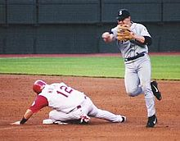
Round 4: PE / Sports
Question #1:
What is the term for a play in baseball in which two outs are recorded during the same continuous playing action?
Twelve: State Final
Copyright © 2014. All Rights Reserved.
North Carolina Association for Scholastic Activities
Notes:
Three second question slide

Slide 107
Round 4: PE / Sports
Question #1:
What is the term for a play in baseball in which two outs are recorded during the same continuous playing action?
Twelve: State Final
Copyright © 2014. All Rights Reserved.
North Carolina Association for Scholastic Activities
Notes:
Three second question slide

Slide 108
Round 4: PE / Sports
Question #2:
Nephrons are the functional units of what paired organs that excrete urea to produce urine?
Twelve: State Final
Copyright © 2014. All Rights Reserved.
North Carolina Association for Scholastic Activities
Notes:
Three second question slide

Slide 109
Round 4: PE / Sports
Question #2:
Nephrons are the functional units of what paired organs that excrete urea to produce urine?
Twelve: State Final
Copyright © 2014. All Rights Reserved.
North Carolina Association for Scholastic Activities
Notes:
Three second question slide

Slide 110
Round 4: PE / Sports
Question #3:
What racket sport is played by two athletes who hit a shuttlecock?
Twelve: State Final
Copyright © 2014. All Rights Reserved.
North Carolina Association for Scholastic Activities
Notes:
Three second question slide

Slide 111
Round 4: PE / Sports
Question #3:
What racket sport is played by two athletes who hit a shuttlecock?
Twelve: State Final
Copyright © 2014. All Rights Reserved.
North Carolina Association for Scholastic Activities
Notes:
Three second question slide

Slide 112
Round 4: PE / Sports
Question #4:
What hormone responsible for the “fight or flight” reflex is produced by a namesake gland?
Twelve: State Final
Copyright © 2014. All Rights Reserved.
North Carolina Association for Scholastic Activities
Notes:
Three second question slide

Slide 113
Round 4: PE / Sports
Question #4:
What hormone responsible for the “fight or flight” reflex is produced by a namesake gland?
Twelve: State Final
Copyright © 2014. All Rights Reserved.
North Carolina Association for Scholastic Activities
Notes:
Three second question slide

Slide 114
Round 4: PE / Sports
Question #5:
What position in football stands behind and supports the defensive ends and defensive tackles?
Twelve: State Final
Copyright © 2014. All Rights Reserved.
North Carolina Association for Scholastic Activities
Notes:
Three second question slide

Slide 115
Round 4: PE / Sports
Question #5:
What position in football stands behind and supports the defensive ends and defensive tackles?
Twelve: State Final
Copyright © 2014. All Rights Reserved.
North Carolina Association for Scholastic Activities
Notes:
Three second question slide

Slide 116
Round 4: PE / Sports
Question #6:
For his work investigating a cholera outbreak in London, John Snow is credited with inventing what field of study which examines how diseases spread?
Twelve: State Final
Copyright © 2014. All Rights Reserved.
North Carolina Association for Scholastic Activities
Notes:
Three second question slide

Slide 117
Round 4: PE / Sports
Question #6:
For his work investigating a cholera outbreak in London, John Snow is credited with inventing what field of study which examines how diseases spread?
Twelve: State Final
Copyright © 2014. All Rights Reserved.
North Carolina Association for Scholastic Activities
Notes:
Three second question slide

Slide 118
Round 4: PE / Sports
Question #7:
What is the term for a basketball foul that doesn’t involve contact between players?
Twelve: State Final
Copyright © 2014. All Rights Reserved.
North Carolina Association for Scholastic Activities
Notes:
Three second question slide

Slide 119
Round 4: PE / Sports
Question #7:
What is the term for a basketball foul that doesn’t involve contact between players?
Twelve: State Final
Copyright © 2014. All Rights Reserved.
North Carolina Association for Scholastic Activities
Notes:
Three second question slide

Slide 120
Round 4: PE / Sports
Question #8:
People are recommended to drink plenty of water after athletic activity to prevent what condition, the lack of sufficient fluids in the body?
.
Twelve: State Final
Copyright © 2014. All Rights Reserved.
North Carolina Association for Scholastic Activities
Notes:
Three second question slide

Slide 121
Round 4: PE / Sports
Question #8:
People are recommended to drink plenty of water after athletic activity to prevent what condition, the lack of sufficient fluids in the body?
.
Twelve: State Final
Copyright © 2014. All Rights Reserved.
North Carolina Association for Scholastic Activities
Notes:
Three second question slide

Slide 122
Round 4: PE / Sports
Question #9:
What governing body of soccer organizes the World Cup?
Twelve: State Final
Copyright © 2014. All Rights Reserved.
North Carolina Association for Scholastic Activities
Notes:
Three second question slide

Slide 123
Round 4: PE / Sports
Question #9:
What governing body of soccer organizes the World Cup?
Twelve: State Final
Copyright © 2014. All Rights Reserved.
North Carolina Association for Scholastic Activities
Notes:
Three second question slide

Slide 124
Round 4: PE / Sports
What figure heads the House of Representatives?
Question #10:
Some types of diabetics have to inject what substance that reduces blood sugar levels?
Twelve: State Final
Copyright © 2014. All Rights Reserved.
North Carolina Association for Scholastic Activities
Notes:
Three second question slide

Slide 125
Round 4: PE / Sports
What figure heads the House of Representatives?
Question #10:
Some types of diabetics have to inject what substance that reduces blood sugar levels?
Twelve: State Final
Copyright © 2014. All Rights Reserved.
North Carolina Association for Scholastic Activities
Notes:
Three second question slide

Slide 126
Round 4: PE / Sports
What figure heads the House of Representatives?
Question #11:
Paradoxical undressing is a symptom of what condition in which a person’s body temperature falls to unsafe levels?
Twelve: State Final
Copyright © 2014. All Rights Reserved.
North Carolina Association for Scholastic Activities
Notes:
Three second question slide

Slide 127
Round 4: PE / Sports
What figure heads the House of Representatives?
Question #11:
Paradoxical undressing is a symptom of what condition in which a person’s body temperature falls to unsafe levels?
Twelve: State Final
Copyright © 2014. All Rights Reserved.
North Carolina Association for Scholastic Activities
Notes:
Three second question slide

Slide 128
Round 4: PE / Sports
Question #12:
In what sport do the contestants use foils, epees, and sabers?
Twelve: State Final
Copyright © 2014. All Rights Reserved.
North Carolina Association for Scholastic Activities
Notes:
Three second question slide

Slide 129
Round 4: PE / Sports
Question #12:
In what sport do the contestants use foils, epees, and sabers?
Twelve: State Final
Copyright © 2014. All Rights Reserved.
North Carolina Association for Scholastic Activities
Notes:
Three second question slide

Slide 130
Round 4: PE / Sports
Students have 3 minutes to complete their answer sheets.
Twelve: State Final
Copyright © 2014. All Rights Reserved.
North Carolina Association for Scholastic Activities
Notes:
Answer sheet warnings

Slide 131
Round 4: PE / Sports
Students have 3 minutes to complete their answer sheets.
2 Minutes Remaining
Twelve: State Final
Copyright © 2014. All Rights Reserved.
North Carolina Association for Scholastic Activities
Notes:
Answer sheet warning: 2 minutes

Slide 132
Round 4: PE / Sports
Students have 3 minutes to complete their answer sheets.
1 Minute Remaining
Twelve: State Final
Copyright © 2014. All Rights Reserved.
North Carolina Association for Scholastic Activities
Notes:
Answer sheet warning: 1 minute

Slide 133
Round 4: PE / Sports
Students have 3 minutes to complete their answer sheets.
12 Seconds Remaining
Twelve: State Final
Copyright © 2014. All Rights Reserved.
North Carolina Association for Scholastic Activities
Notes:
Answer sheet warning: 12 seconds

Slide 134
Round 4: PE / Sports
TIME
Pencils Down.
Answer sheets will now be collected.
Twelve: State Final
Copyright © 2014. All Rights Reserved.
North Carolina Association for Scholastic Activities
Notes:
Answer sheet: time

Slide 135
Round 4: PE / Sports
Answers for PE / Sports questions follow on next slide.
Advance once all answer sheets have been collected.
Group D Students may return to their team.
Group A Students may be seated.
Twelve: State Final
Copyright © 2014. All Rights Reserved.
North Carolina Association for Scholastic Activities
Notes:
Prep for answers

Slide 136
Round 4: PE / Sports
Answers
Double Play
Kidneys
Badminton
Adrenaline
Linebacker
Epidemiology
Technical foul
Dehydration
FIFA [or Fédération Internationale de Football Association; or International Federation of Association Football]
Insulin
Hypothermia
Fencing
Twelve: State Final
Copyright © 2014. All Rights Reserved.
North Carolina Association for Scholastic Activities
Notes:
Answers

Slide 137
Round 5: NC Colleges and Univ.
Group A Students are seated and ready to begin.
Twelve: State Final
Copyright © 2014. All Rights Reserved.
North Carolina Association for Scholastic Activities
Notes:
Seated and ready to go

Slide 138
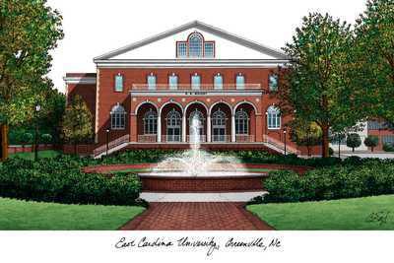
Round 5: NC Colleges and Univ.
Question #1:
What university began as “teacher’s training school” with groundbreaking in 1908? Governor Thomas Jordan Jarvis was known as the father of this university in Greenville.
3s
Twelve: State Final
Copyright © 2014. All Rights Reserved.
North Carolina Association for Scholastic Activities
Notes:
Three second question slide

Slide 139
Round 5: NC Colleges and Univ.
Question #1:
What university began as “teacher’s training school” with groundbreaking in 1908? Governor Thomas Jordan Jarvis was known as the father of this university in Greenville.
3s
Twelve: State Final
Copyright © 2014. All Rights Reserved.
North Carolina Association for Scholastic Activities
Notes:
Three second question slide

Slide 140
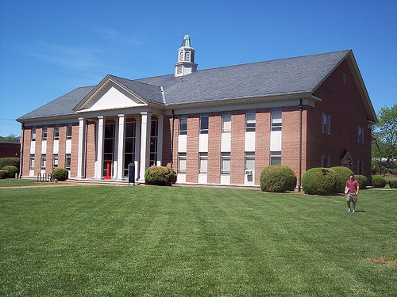
Round 5: NC Colleges and Univ.
Question #2:
Brevard College is a small liberal arts college located in what Transylvania County town?
3s
Twelve: State Final
Copyright © 2014. All Rights Reserved.
North Carolina Association for Scholastic Activities
Notes:
Three second question slide

Slide 141
Round 5: NC Colleges and Univ.
Question #2:
Brevard College is a small liberal arts college located in what Transylvania County town?
3s
Twelve: State Final
Copyright © 2014. All Rights Reserved.
North Carolina Association for Scholastic Activities
Notes:
Three second question slide

Slide 142
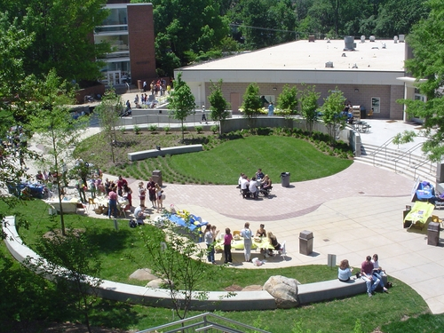
Round 5: NC Colleges and Univ.
Question #3:
What Winston-Salem institution, home of the Fighting Pickles, is unique because it awards high school, undergraduate, and graduate degrees to its students?
3s
Twelve: State Final
Copyright © 2014. All Rights Reserved.
North Carolina Association for Scholastic Activities
Notes:
Three second question slide

Slide 143
Round 5: NC Colleges and Univ.
Question #3:
What Winston-Salem institution, home of the Fighting Pickles, is unique because it awards high school, undergraduate, and graduate degrees to its students?
3s
Twelve: State Final
Copyright © 2014. All Rights Reserved.
North Carolina Association for Scholastic Activities
Notes:
Three second question slide

Slide 144
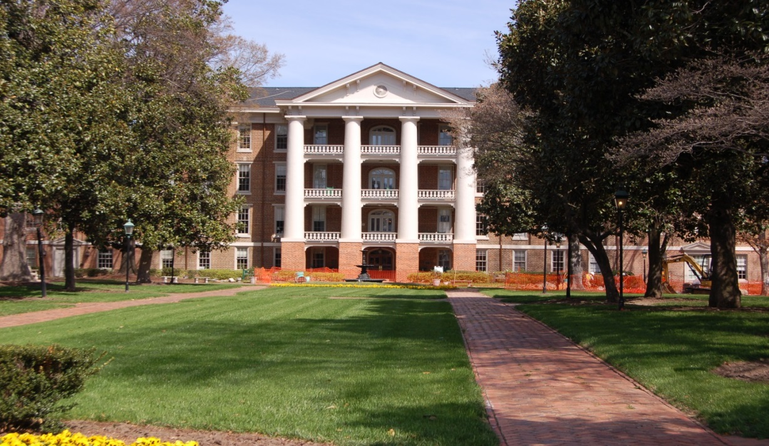
Round 5: NC Colleges and Univ.
Question #4:
Concurrent with the announcement that the school would begin accepting men, Peace College changed its name to what in 2012?
3s
Twelve: State Final
Copyright © 2014. All Rights Reserved.
North Carolina Association for Scholastic Activities
Notes:
Three second question slide

Slide 145
Round 5: NC Colleges and Univ.
Question #4:
Concurrent with the announcement that the school would begin accepting men, Peace College changed its name to what in 2012?
3s
Twelve: State Final
Copyright © 2014. All Rights Reserved.
North Carolina Association for Scholastic Activities
Notes:
Three second question slide

Slide 146
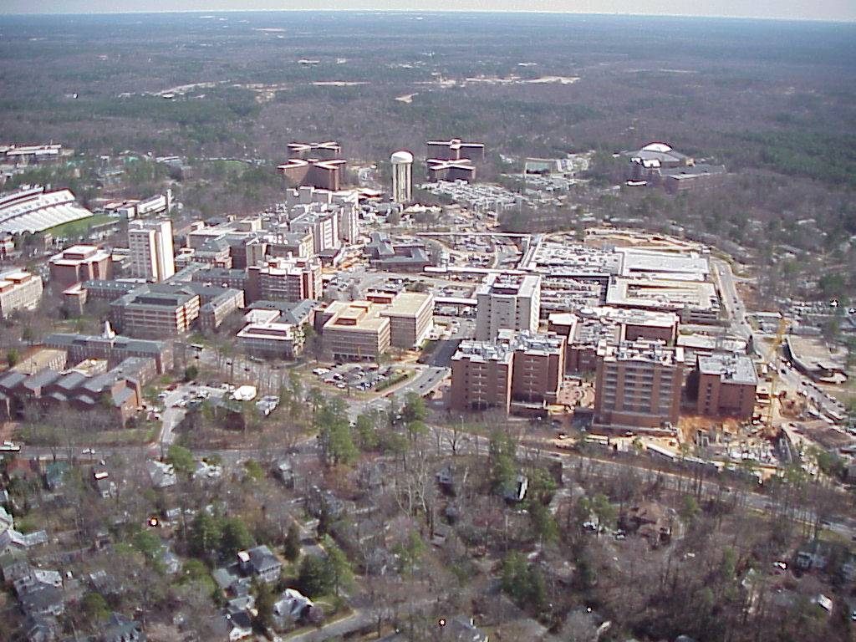
Round 5: NC Colleges and Univ.
Question #5:
What North Carolina public university opened its doors in 1795 as the first public university in the United States?
3s
Twelve: State Final
Copyright © 2014. All Rights Reserved.
North Carolina Association for Scholastic Activities
Notes:
Three second question slide

Slide 147
Round 5: NC Colleges and Univ.
Question #5:
What North Carolina public university opened its doors in 1795 as the first public university in the United States?
3s
Twelve: State Final
Copyright © 2014. All Rights Reserved.
North Carolina Association for Scholastic Activities
Notes:
Three second question slide

Slide 148
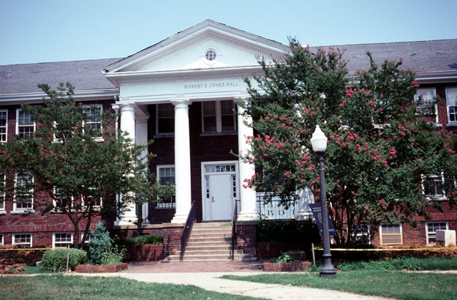
Round 5: NC Colleges and Univ.
Question #6:
What North Carolina city is home to more than five colleges and universities including Bennett College and UNC-G?
3s
Twelve: State Final
Copyright © 2014. All Rights Reserved.
North Carolina Association for Scholastic Activities
Notes:
Three second question slide

Slide 149
Round 5: NC Colleges and Univ.
Question #6:
What North Carolina city is home to more than five colleges and universities including Bennett College and UNC-G?
3s
Twelve: State Final
Copyright © 2014. All Rights Reserved.
North Carolina Association for Scholastic Activities
Notes:
Three second question slide

Slide 150
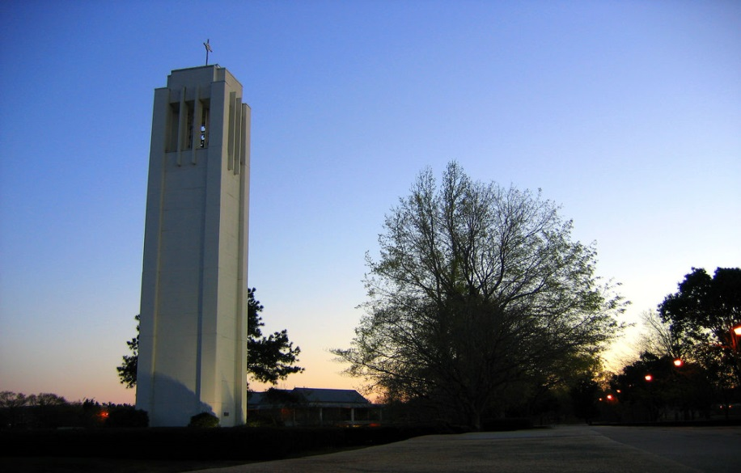
Round 5: NC Colleges and Univ.
Question #7:
What Laurinburg institution was formed with the merger of Flora McDonald College and Presbyterian Junior College? It added its first graduate degree program in 2013.
3s
Twelve: State Final
Copyright © 2014. All Rights Reserved.
North Carolina Association for Scholastic Activities
Notes:
Three second question slide

Slide 151
Round 5: NC Colleges and Univ.
Question #7:
What Laurinburg institution was formed with the merger of Flora McDonald College and Presbyterian Junior College? It added its first graduate degree program in 2013.
3s
Twelve: State Final
Copyright © 2014. All Rights Reserved.
North Carolina Association for Scholastic Activities
Notes:
Three second question slide

Slide 152
Round 5: NC Colleges and Univ.
Question #8:
What Wayne County institution chartered in 1951 announced a name change from college to university in December, 2013?
3s
Twelve: State Final
Copyright © 2014. All Rights Reserved.
North Carolina Association for Scholastic Activities
Notes:
Three second question slide

Slide 153
Round 5: NC Colleges and Univ.
Question #8:
What Wayne County institution chartered in 1951 announced a name change from college to university in December, 2013?
3s
Twelve: State Final
Copyright © 2014. All Rights Reserved.
North Carolina Association for Scholastic Activities
Notes:
Three second question slide

Slide 154
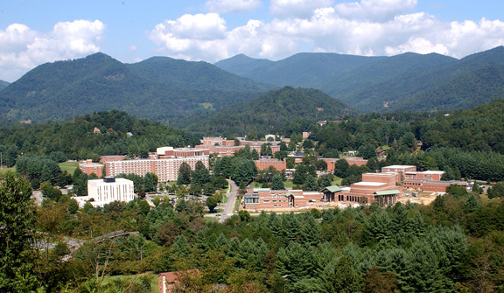
Round 5: NC Colleges and Univ.
Question #9:
What purple and gold university led by David Belcher is located in Cullowhee?
3s
Twelve: State Final
Copyright © 2014. All Rights Reserved.
North Carolina Association for Scholastic Activities
Notes:
Three second question slide

Slide 155
Round 5: NC Colleges and Univ.
Question #9:
What purple and gold university led by David Belcher is located in Cullowhee?
3s
Twelve: State Final
Copyright © 2014. All Rights Reserved.
North Carolina Association for Scholastic Activities
Notes:
Three second question slide

Slide 156
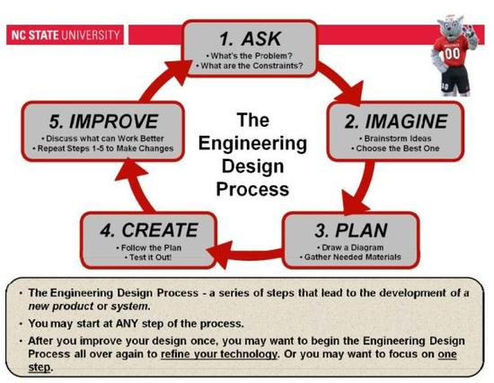
Round 5: NC Colleges and Univ.
Question #10:
While more than a dozen NC universities offer engineering degrees, which is the largest with more students and over a dozen majors?
3s
Twelve: State Final
Copyright © 2014. All Rights Reserved.
North Carolina Association for Scholastic Activities
Notes:
Three second question slide

Slide 157
Round 5: NC Colleges and Univ.
Question #10:
While more than a dozen NC universities offer engineering degrees, which is the largest with more students and over a dozen majors?
3s
Twelve: State Final
Copyright © 2014. All Rights Reserved.
North Carolina Association for Scholastic Activities
Notes:
Three second question slide

Slide 158
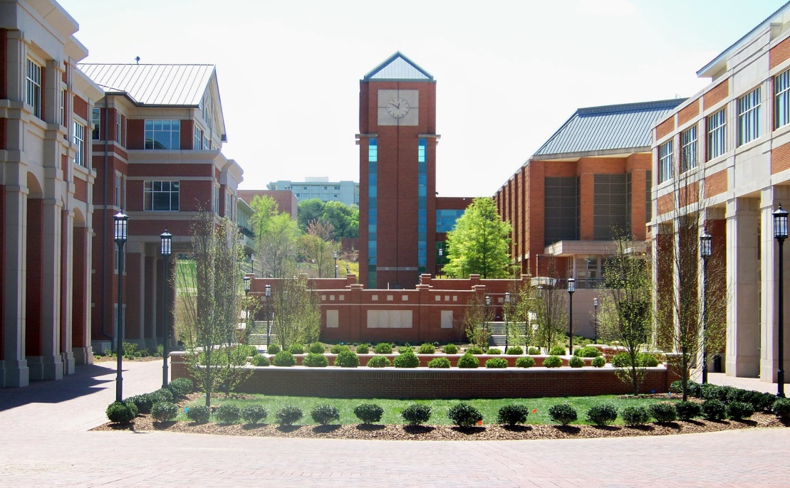
Round 5: NC Colleges and Univ.
Question #11:
What Mecklenburg County university opened in 1946 was founded to serve the education needs of post-World War II veterans? It was known in the 1950’s as Charlotte College.
3s
Twelve: State Final
Copyright © 2014. All Rights Reserved.
North Carolina Association for Scholastic Activities
Notes:
Three second question slide

Slide 159
Round 5: NC Colleges and Univ.
Question #11:
What Mecklenburg County university opened in 1946 was founded to serve the education needs of post-World War II veterans? It was known in the 1950’s as Charlotte College.
3s
Twelve: State Final
Copyright © 2014. All Rights Reserved.
North Carolina Association for Scholastic Activities
Notes:
Three second question slide

Slide 160
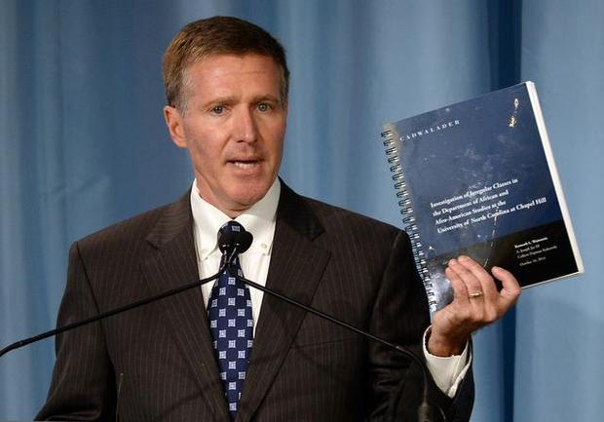
Round 5: NC Colleges and Univ.
Question #12:
The Wainstein Report, published in October 2014, described academic fraud at what North Carolina university?
3s
Twelve: State Final
Copyright © 2014. All Rights Reserved.
North Carolina Association for Scholastic Activities
Notes:
Three second question slide

Slide 161
Round 5: NC Colleges and Univ.
Question #12:
The Wainstein Report, published in October 2014, described academic fraud at what North Carolina university?
3s
Twelve: State Final
Copyright © 2014. All Rights Reserved.
North Carolina Association for Scholastic Activities
Notes:
Three second question slide

Slide 162
Round 5: NC Colleges and Univ.
Students have 3 minutes to complete their answer sheets.
Twelve: State Final
Copyright © 2014. All Rights Reserved.
North Carolina Association for Scholastic Activities
Notes:
Answer sheet warnings

Slide 163
Round 5: NC Colleges and Univ.
Students have 3 minutes to complete their answer sheets.
2 Minutes Remaining
Twelve: State Final
Copyright © 2014. All Rights Reserved.
North Carolina Association for Scholastic Activities
Notes:
Answer sheet warning: 2 minutes

Slide 164
Round 5: NC Colleges and Univ.
Students have 3 minutes to complete their answer sheets.
1 Minute Remaining
Twelve: State Final
Copyright © 2014. All Rights Reserved.
North Carolina Association for Scholastic Activities
Notes:
Answer sheet warning: 1 minute

Slide 165
Round 5: NC Colleges and Univ.
Students have 3 minutes to complete their answer sheets.
12 Seconds Remaining
Twelve: State Final
Copyright © 2014. All Rights Reserved.
North Carolina Association for Scholastic Activities
Notes:
Answer sheet warning: 12 seconds

Slide 166
Round 5: NC Colleges and Univ.
TIME
Pencils Down.
Answer sheets will now be collected.
Twelve: State Final
Copyright © 2014. All Rights Reserved.
North Carolina Association for Scholastic Activities
Notes:
Answer sheet: time

Slide 167
Round 5: NC Colleges and Univ.
Answers for NC Colleges and Universities questions follow on next slide.
Advance once all answer sheets have been collected.
Group A Students may return to their team.
Group B Students may be seated.
Twelve: State Final
Copyright © 2014. All Rights Reserved.
North Carolina Association for Scholastic Activities
Notes:
Prep for answers

Slide 168
Round 5: NC Colleges and Univ.
Answers
East Carolina University or ECU
Brevard
UNC School of the Arts
William Peace University
University of North Carolina or UNC
Greensboro
St. Andrews University
Mount Olive University or UMO
Western Carolina University or WCU
NC State University or NCSU
UNC-Charlotte
University of North Carolina or UNC
Twelve: State Final
Copyright © 2014. All Rights Reserved.
North Carolina Association for Scholastic Activities
Notes:
Answers

Slide 169
Round 6: Literature
Group B Students are seated and ready to begin.
Twelve: State Final
Copyright © 2014. All Rights Reserved.
North Carolina Association for Scholastic Activities
Notes:
Seated and ready to go

Slide 170
Round 6: Literature
Question #1:
While lost with Becky Thatcher, the protagonist of what Mark Twain novel finds Injun Joe’s gold?
3s
Twelve: State Final
Copyright © 2014. All Rights Reserved.
North Carolina Association for Scholastic Activities
Notes:
Three second question slide

Slide 171
Round 6: Literature
Question #1:
While lost with Becky Thatcher, the protagonist of what Mark Twain novel finds Injun Joe’s gold?
3s
Twelve: State Final
Copyright © 2014. All Rights Reserved.
North Carolina Association for Scholastic Activities
Notes:
Three second question slide

Slide 172
Round 6: Literature
Question #2:
Holden Caulfield’s angst-filled thoughts and experiences in New York City are the subject of what J.D. Salinger novel?
3s
Twelve: State Final
Copyright © 2014. All Rights Reserved.
North Carolina Association for Scholastic Activities
Notes:
Three second question slide

Slide 173
Round 6: Literature
Question #2:
Holden Caulfield’s angst-filled thoughts and experiences in New York City are the subject of what J.D. Salinger novel?
3s
Twelve: State Final
Copyright © 2014. All Rights Reserved.
North Carolina Association for Scholastic Activities
Notes:
Three second question slide

Slide 174
Round 6: Literature
Question #3:
What English mariner who becomes a castaway is the namesake protagonist of Daniel Defoe novel?
3s
Twelve: State Final
Copyright © 2014. All Rights Reserved.
North Carolina Association for Scholastic Activities
Notes:
Three second question slide

Slide 175
Round 6: Literature
Question #3:
What English mariner who becomes a castaway is the namesake protagonist of Daniel Defoe novel?
3s
Twelve: State Final
Copyright © 2014. All Rights Reserved.
North Carolina Association for Scholastic Activities
Notes:
Three second question slide

Slide 176
Round 6: Literature
Question #4:
What novel about a friend of Sancho Panza who charges windmills was written by Miguel de Cervantes?
3s
Twelve: State Final
Copyright © 2014. All Rights Reserved.
North Carolina Association for Scholastic Activities
Notes:
Three second question slide

Slide 177
Round 6: Literature
Question #4:
What novel about a friend of Sancho Panza who charges windmills was written by Miguel de Cervantes?
3s
Twelve: State Final
Copyright © 2014. All Rights Reserved.
North Carolina Association for Scholastic Activities
Notes:
Three second question slide

Slide 178
Round 6: Literature
Question #5:
A Native American warrior named Little Bear who fought in the French and Indian War is the title figure of what novel? This novel’s protagonist is Omri, who can bring toys to life using a magic key.
3s
Twelve: State Final
Copyright © 2014. All Rights Reserved.
North Carolina Association for Scholastic Activities
Notes:
Three second question slide

Slide 179
Round 6: Literature
Question #5:
A Native American warrior named Little Bear who fought in the French and Indian War is the title figure of what novel? This novel’s protagonist is Omri, who can bring toys to life using a magic key.
3s
Twelve: State Final
Copyright © 2014. All Rights Reserved.
North Carolina Association for Scholastic Activities
Notes:
Three second question slide

Slide 180
Round 6: Literature
Question #6:
What Danish author wrote “The Ugly Duckling” and “The Little Mermaid?”
3s
Twelve: State Final
Copyright © 2014. All Rights Reserved.
North Carolina Association for Scholastic Activities
Notes:
Three second question slide

Slide 181
Round 6: Literature
Question #6:
What Danish author wrote “The Ugly Duckling” and “The Little Mermaid?”
3s
Twelve: State Final
Copyright © 2014. All Rights Reserved.
North Carolina Association for Scholastic Activities
Notes:
Three second question slide

Slide 182
Round 6: Literature
Question #7:
Peeta Mellark reveals his feelings for the protagonist of what Suzanne Collins novel about Katniss Everdeen? It is the namesake of a series.
3s
Twelve: State Final
Copyright © 2014. All Rights Reserved.
North Carolina Association for Scholastic Activities
Notes:
Three second question slide

Slide 183
Round 6: Literature
Question #7:
Peeta Mellark reveals his feelings for the protagonist of what Suzanne Collins novel about Katniss Everdeen? It is the namesake of a series.
3s
Twelve: State Final
Copyright © 2014. All Rights Reserved.
North Carolina Association for Scholastic Activities
Notes:
Three second question slide

Slide 184
Round 6: Literature
Question #8:
The destruction of a forest of Truffula Trees appears in The Lorax, a work by what author who created a character who eats cake in the bathtub and unleashes Thing 1 and Thing 2 in The Cat in the Hat?
3s
Twelve: State Final
Copyright © 2014. All Rights Reserved.
North Carolina Association for Scholastic Activities
Notes:
Three second question slide

Slide 185
Round 6: Literature
Question #8:
The destruction of a forest of Truffula Trees appears in The Lorax, a work by what author who created a character who eats cake in the bathtub and unleashes Thing 1 and Thing 2 in The Cat in the Hat?
3s
Twelve: State Final
Copyright © 2014. All Rights Reserved.
North Carolina Association for Scholastic Activities
Notes:
Three second question slide

Slide 186
Round 6: Literature
Question #9:
The sequel to what work by Jeff Kinney was subtitled “Rodrick Rules?” This “novel in cartoons” centers on Greg Heffley and Rowley Jefferson and launched a series.
3s
Twelve: State Final
Copyright © 2014. All Rights Reserved.
North Carolina Association for Scholastic Activities
Notes:
Three second question slide

Slide 187
Round 6: Literature
Question #9:
The sequel to what work by Jeff Kinney was subtitled “Rodrick Rules?” This “novel in cartoons” centers on Greg Heffley and Rowley Jefferson and launched a series.
3s
Twelve: State Final
Copyright © 2014. All Rights Reserved.
North Carolina Association for Scholastic Activities
Notes:
Three second question slide

Slide 188
Round 6: Literature
Question #10:
What father of Draco Malfoy is a prominent Death Eater in the Harry Potter series?
3s
Twelve: State Final
Copyright © 2014. All Rights Reserved.
North Carolina Association for Scholastic Activities
Notes:
Three second question slide

Slide 189
Round 6: Literature
Question #10:
What father of Draco Malfoy is a prominent Death Eater in the Harry Potter series?
3s
Twelve: State Final
Copyright © 2014. All Rights Reserved.
North Carolina Association for Scholastic Activities
Notes:
Three second question slide

Slide 190
Round 6: Literature
Question #11:
What novel by Dan Brown features a conflict between the Priory of Sion and Opus Dei? It includes the character of Silas, an albino monk.
3s
Twelve: State Final
Copyright © 2014. All Rights Reserved.
North Carolina Association for Scholastic Activities
Notes:
Three second question slide

Slide 191
Round 6: Literature
Question #11:
What novel by Dan Brown features a conflict between the Priory of Sion and Opus Dei? It includes the character of Silas, an albino monk.
3s
Twelve: State Final
Copyright © 2014. All Rights Reserved.
North Carolina Association for Scholastic Activities
Notes:
Three second question slide

Slide 192
Round 6: Literature
Question #12:
What monkey created by Margret and H.A. Rey floats using a bunch of balloons before being rescued by the Man in the Yellow Hat? He is the protagonist of a namesake series.
3s
Twelve: State Final
Copyright © 2014. All Rights Reserved.
North Carolina Association for Scholastic Activities
Notes:
Three second question slide

Slide 193
Round 6: Literature
Question #12:
What monkey created by Margret and H.A. Rey floats using a bunch of balloons before being rescued by the Man in the Yellow Hat? He is the protagonist of a namesake series.
3s
Twelve: State Final
Copyright © 2014. All Rights Reserved.
North Carolina Association for Scholastic Activities
Notes:
Three second question slide

Slide 194
Round 6: Literature
Students have 3 minutes to complete their answer sheets.
Twelve: State Final
Copyright © 2014. All Rights Reserved.
North Carolina Association for Scholastic Activities
Notes:
Answer sheet warnings

Slide 195
Round 6: Literature
Students have 3 minutes to complete their answer sheets.
2 Minutes Remaining
Twelve: State Final
Copyright © 2014. All Rights Reserved.
North Carolina Association for Scholastic Activities
Notes:
Answer sheet warning: 2 minutes

Slide 196
Round 6: Literature
Students have 3 minutes to complete their answer sheets.
1 Minute Remaining
Twelve: State Final
Copyright © 2014. All Rights Reserved.
North Carolina Association for Scholastic Activities
Notes:
Answer sheet warning: 1 minute

Slide 197
Round 6: Literature
Students have 3 minutes to complete their answer sheets.
12 Seconds Remaining
Twelve: State Final
Copyright © 2014. All Rights Reserved.
North Carolina Association for Scholastic Activities
Notes:
Answer sheet warning: 12 seconds

Slide 198
Round 6: Literature
TIME
Pencils Down.
Answer sheets will now be collected.
Twelve: State Final
Copyright © 2014. All Rights Reserved.
North Carolina Association for Scholastic Activities
Notes:
Answer sheet: time

Slide 199
Round 6: Literature
Answers for Literature questions follow on next slide.
Advance once all answer sheets have been collected.
Group B Students may return to their team.
Group C Students may be seated.
Twelve: State Final
Copyright © 2014. All Rights Reserved.
North Carolina Association for Scholastic Activities
Notes:
Prep for answers

Slide 200
Round 6: Literature
Answers
The Adventures of Tom Sawyer
The Catcher in the Rye
Robinson Crusoe [accept either]
Don Quixote
The Indian in the Cupboard
Hans Christian Andersen
The Hunger Games
Dr. Seuss or Theodore Geisel [accept Theo LeSieg]
Diary of a Wimpy Kid
Lucius Malfoy
The Da Vinci Code
Curious George
Twelve: State Final
Copyright © 2014. All Rights Reserved.
North Carolina Association for Scholastic Activities
Notes:
Answers

Slide 201
Round 7: US History
Group C Students are seated and ready to begin.
Twelve: State Final
Copyright © 2014. All Rights Reserved.
North Carolina Association for Scholastic Activities
Notes:
Seated and ready to go

Slide 202
Round 7: US History
Question #1:
What scandal in which seven men were caught breaking into the Democratic headquarters in Washington, D.C. caused Richard Nixon's resignation?
Twelve: State Final
Copyright © 2014. All Rights Reserved.
North Carolina Association for Scholastic Activities
Notes:
Three second question slide

Slide 203
Round 7: US History
Question #1:
What scandal in which seven men were caught breaking into the Democratic headquarters in Washington, D.C. caused Richard Nixon's resignation?
Twelve: State Final
Copyright © 2014. All Rights Reserved.
North Carolina Association for Scholastic Activities
Notes:
Three second question slide

Slide 204
Round 7: US History
Question #2:
What process ending in 1877 saw Northern troops occupy and helped restore the South after the Civil War?
Twelve: State Final
Copyright © 2014. All Rights Reserved.
North Carolina Association for Scholastic Activities
Notes:
Three second question slide

Slide 205
Round 7: US History
Question #2:
What process ending in 1877 saw Northern troops occupy and helped restore the South after the Civil War?
Twelve: State Final
Copyright © 2014. All Rights Reserved.
North Carolina Association for Scholastic Activities
Notes:
Three second question slide

Slide 206
Round 7: US History
Question #3:
What politician and orator from Virginia exclaimed, “Give me liberty or give me death!”?
Twelve: State Final
Copyright © 2014. All Rights Reserved.
North Carolina Association for Scholastic Activities
Notes:
Three second question slide

Slide 207
Round 7: US History
Question #3:
What politician and orator from Virginia exclaimed, “Give me liberty or give me death!”?
Twelve: State Final
Copyright © 2014. All Rights Reserved.
North Carolina Association for Scholastic Activities
Notes:
Three second question slide

Slide 208
Round 7: US History
Question #4:
The US war in the Pacific in World War II began with what Japanese attack on this Hawaiian naval base?
Twelve: State Final
Copyright © 2014. All Rights Reserved.
North Carolina Association for Scholastic Activities
Notes:
Three second question slide

Slide 209
Round 7: US History
Question #4:
The US war in the Pacific in World War II began with what Japanese attack on this Hawaiian naval base?
Twelve: State Final
Copyright © 2014. All Rights Reserved.
North Carolina Association for Scholastic Activities
Notes:
Three second question slide

Slide 210
Round 7: US History
Question #5:
Abraham Lincoln delivered a famous address dedicating a national cemetery at the site of what battle that saw fighting at Little Round Top and Devil’s Den?
Twelve: State Final
Copyright © 2014. All Rights Reserved.
North Carolina Association for Scholastic Activities
Notes:
Three second question slide

Slide 211
Round 7: US History
Question #5:
Abraham Lincoln delivered a famous address dedicating a national cemetery at the site of what battle that saw fighting at Little Round Top and Devil’s Den?
Twelve: State Final
Copyright © 2014. All Rights Reserved.
North Carolina Association for Scholastic Activities
Notes:
Three second question slide

Slide 212
Round 7: US History
Question #6:
Franklin Delano Roosevelt implemented what expansive set of policies to help end the Great Depression? Its second phase gave rise to such developments as the Social Security Act.
Twelve: State Final
Copyright © 2014. All Rights Reserved.
North Carolina Association for Scholastic Activities
Notes:
Three second question slide

Slide 213
Round 7: US History
Question #6:
Franklin Delano Roosevelt implemented what expansive set of policies to help end the Great Depression? Its second phase gave rise to such developments as the Social Security Act.
Twelve: State Final
Copyright © 2014. All Rights Reserved.
North Carolina Association for Scholastic Activities
Notes:
Three second question slide

Slide 214
Round 7: US History
Question #7:
What settlement in the Virginia Colony was the first permanent English settlement in the United States?
Twelve: State Final
Copyright © 2014. All Rights Reserved.
North Carolina Association for Scholastic Activities
Notes:
Three second question slide

Slide 215
Round 7: US History
Question #7:
What settlement in the Virginia Colony was the first permanent English settlement in the United States?
Twelve: State Final
Copyright © 2014. All Rights Reserved.
North Carolina Association for Scholastic Activities
Notes:
Three second question slide

Slide 216
Round 7: US History
Question #8:
George H.W. Bush’s tenure saw what war in which a coalition of nations attacked Iraq after Saddam Hussein ordered the invasion of Kuwait?
Twelve: State Final
Copyright © 2014. All Rights Reserved.
North Carolina Association for Scholastic Activities
Notes:
Three second question slide

Slide 217
Round 7: US History
Question #8:
George H.W. Bush’s tenure saw what war in which a coalition of nations attacked Iraq after Saddam Hussein ordered the invasion of Kuwait?
Twelve: State Final
Copyright © 2014. All Rights Reserved.
North Carolina Association for Scholastic Activities
Notes:
Three second question slide

Slide 218
Round 7: US History
Question #9:
Elizabeth Cady Stanton and Susan B. Anthony drafted what amendment which gave women in the US the right to vote?
Twelve: State Final
Copyright © 2014. All Rights Reserved.
North Carolina Association for Scholastic Activities
Notes:
Three second question slide

Slide 219
Round 7: US History
Question #9:
Elizabeth Cady Stanton and Susan B. Anthony drafted what amendment which gave women in the US the right to vote?
Twelve: State Final
Copyright © 2014. All Rights Reserved.
North Carolina Association for Scholastic Activities
Notes:
Three second question slide

Slide 220
Round 7: US History
Question #10:
The Bull Moose Party was led by what president who, during the Spanish American War, led the Rough Riders up San Juan Hill?
Twelve: State Final
Copyright © 2014. All Rights Reserved.
North Carolina Association for Scholastic Activities
Notes:
Three second question slide

Slide 221
Round 7: US History
Question #10:
The Bull Moose Party was led by what president who, during the Spanish American War, led the Rough Riders up San Juan Hill?
Twelve: State Final
Copyright © 2014. All Rights Reserved.
North Carolina Association for Scholastic Activities
Notes:
Three second question slide

Slide 222
Round 7: US History
Question #11:
Plymouth Plantation eventually became part of which of the Thirteen Colonies?
Twelve: State Final
Copyright © 2014. All Rights Reserved.
North Carolina Association for Scholastic Activities
Notes:
Three second question slide

Slide 223
Round 7: US History
Question #11:
Plymouth Plantation eventually became part of which of the Thirteen Colonies?
Twelve: State Final
Copyright © 2014. All Rights Reserved.
North Carolina Association for Scholastic Activities
Notes:
Three second question slide

Slide 224
Round 7: US History
Question #12:
The Lewis and Clark expedition and Louisiana Purchase occurred during the presidency of what man who was also the first US Secretary of State?
Twelve: State Final
Copyright © 2014. All Rights Reserved.
North Carolina Association for Scholastic Activities
Notes:
Three second question slide

Slide 225
Round 7: US History
Question #12:
The Lewis and Clark expedition and Louisiana Purchase occurred during the presidency of what man who was also the first US Secretary of State?
Twelve: State Final
Copyright © 2014. All Rights Reserved.
North Carolina Association for Scholastic Activities
Notes:
Three second question slide

Slide 226
Round 7: US History
Students have 3 minutes to complete their answer sheets.
Twelve: State Final
Copyright © 2014. All Rights Reserved.
North Carolina Association for Scholastic Activities
Notes:
Answer sheet warnings

Slide 227
Round 7: US History
Students have 3 minutes to complete their answer sheets.
2 Minutes Remaining
Twelve: State Final
Copyright © 2014. All Rights Reserved.
North Carolina Association for Scholastic Activities
Notes:
Answer sheet warning: 2 minutes

Slide 228
Round 7: US History
Students have 3 minutes to complete their answer sheets.
1 Minute Remaining
Twelve: State Final
Copyright © 2014. All Rights Reserved.
North Carolina Association for Scholastic Activities
Notes:
Answer sheet warning: 1 minute

Slide 229
Round 7: US History
Students have 3 minutes to complete their answer sheets.
12 Seconds Remaining
Twelve: State Final
Copyright © 2014. All Rights Reserved.
North Carolina Association for Scholastic Activities
Notes:
Answer sheet warning: 12 seconds

Slide 230
Round 7: US History
TIME
Pencils Down.
Answer sheets will now be collected.
Twelve: State Final
Copyright © 2014. All Rights Reserved.
North Carolina Association for Scholastic Activities
Notes:
Answer sheet: time

Slide 231
Round 7: US History
Answers for US History questions follow on next slide.
Advance once all answer sheets have been collected.
Group C Students may return to their team.
Group D Students may be seated.
Twelve: State Final
Copyright © 2014. All Rights Reserved.
North Carolina Association for Scholastic Activities
Notes:
Prep for answers

Slide 232
Round 7: US History
Answers
Watergate Scandal
Reconstruction
Patrick Henry
Pearl Harbor
Battle of Gettysburg
New Deal
Jamestown
Persian Gulf War [or Operation Desert Storm]
Nineteenth Amendment
Theodore Roosevelt [or “Teddy” Roosevelt, or TR]
Massachusetts
Thomas Jefferson
Twelve: State Final
Copyright © 2014. All Rights Reserved.
North Carolina Association for Scholastic Activities
Notes:
Answers

Slide 233
Round 8: Mathematics
Group D Students are seated and ready to begin.
Proctor should now distribute math questions face-down to students.
Students may begin when next slide is advanced.
Twelve: State Final
Copyright © 2014. All Rights Reserved.
North Carolina Association for Scholastic Activities
Notes:
Seated and ready to go

Slide 234
Round 8: Mathematics
Question #1:
What is the sine of 90 degrees?
3s
Twelve: State Final
Copyright © 2014. All Rights Reserved.
North Carolina Association for Scholastic Activities
Notes:
Twenty second question slide

Slide 235
Round 8: Mathematics
Question #2:
Richard mails off some equipment to be repaired, thinking the repairs will cost $200. In reality, the price of the repairs has increased by 20% since last time, but Richard also has a coupon which will take 10% off of the final price of the repairs. How much will the equipment actually cost to repair?
3s
Twelve: State Final
Copyright © 2014. All Rights Reserved.
North Carolina Association for Scholastic Activities
Notes:
Twenty second question slide

Slide 236
Round 8: Mathematics
Question #3:
What is the area of a triangle with a base of 6 units and a height of 12 units?
3s
Twelve: State Final
Copyright © 2014. All Rights Reserved.
North Carolina Association for Scholastic Activities
Notes:
Twenty second question slide

Slide 237
Round 8: Mathematics
Question #4:
What is the probability of flipping five heads in a row on a fair coin? You can give the answer as either a fraction or decimal; if the latter, you can give it to just 3 decimal places.
3s
Twelve: State Final
Copyright © 2014. All Rights Reserved.
North Carolina Association for Scholastic Activities
Notes:
Twenty second question slide

Slide 238
Round 8: Mathematics
Question #5:
If x is 9 in the equation y = x + 11, then what is the value of y?
3s
Twelve: State Final
Copyright © 2014. All Rights Reserved.
North Carolina Association for Scholastic Activities
Notes:
Twenty second question slide

Slide 239
Round 8: Mathematics
Question #6:
Jenny is 5 feet tall and looks up at a precise 45 degree angle to the top of a building. If she is standing 10 feet away from the building, how tall is the building? Don’t forget to take Jenny’s height into account in finding the answer.
3s
Twelve: State Final
Copyright © 2014. All Rights Reserved.
North Carolina Association for Scholastic Activities
Notes:
Twenty second question slide

Slide 240
Round 8: Mathematics
Question #7:
What is the circumference of a circle whose radius is 14 units?
3s
Twelve: State Final
Copyright © 2014. All Rights Reserved.
North Carolina Association for Scholastic Activities
Notes:
Twenty second question slide

Slide 241
Round 8: Mathematics
Question #8:
What is the slope of a line that passes through the points (0 , 3) and (5 , 8)?
3s
Twelve: State Final
Copyright © 2014. All Rights Reserved.
North Carolina Association for Scholastic Activities
Notes:
Twenty second question slide

Slide 242
Round 8: Mathematics
Question #9:
What is the positive square root of 196?
3s
Twelve: State Final
Copyright © 2014. All Rights Reserved.
North Carolina Association for Scholastic Activities
Notes:
Twenty second question slide

Slide 243
Round 8: Mathematics
Question #10:
Keisha is designing a building shaped like a circle when she is told that the building’s floor area will have to be quadrupled. Assuming the building stays in the same shape and the original building was 180 feet wide, how wide in feet will the new building be?
3s
Twelve: State Final
Copyright © 2014. All Rights Reserved.
North Carolina Association for Scholastic Activities
Notes:
Twenty second question slide

Slide 244
Round 8: Mathematics
Question #11:
What are the two values of x for which the equation x² + 5x + 6 can be true?
3s
Twelve: State Final
Copyright © 2014. All Rights Reserved.
North Carolina Association for Scholastic Activities
Notes:
Twenty second question slide

Slide 245
Round 8: Mathematics
Question #12:
What is the surface area of a rectangular prism whose side lengths are 5, 8, and 2 units?
3s
Twelve: State Final
Copyright © 2014. All Rights Reserved.
North Carolina Association for Scholastic Activities
Notes:
Twenty second question slide

Slide 246
Round 8: Mathematics
Students have 5 minutes to complete their answer sheets.
Twelve: State Final
Copyright © 2014. All Rights Reserved.
North Carolina Association for Scholastic Activities
Notes:
Answer sheet warnings

Slide 247
Round 8: Mathematics
Students have 5 minutes to complete their answer sheets.
2 Minutes Remaining
Twelve: State Final
Copyright © 2014. All Rights Reserved.
North Carolina Association for Scholastic Activities
Notes:
Answer sheet warning: 2 minutes

Slide 248
Round 8: Mathematics
Students have 5 minutes to complete their answer sheets.
1 Minute Remaining
Twelve: State Final
Copyright © 2014. All Rights Reserved.
North Carolina Association for Scholastic Activities
Notes:
Answer sheet warning: 1 minute

Slide 249
Round 8: Mathematics
Students have 5 minutes to complete their answer sheets.
12 Seconds Remaining
Twelve: State Final
Copyright © 2014. All Rights Reserved.
North Carolina Association for Scholastic Activities
Notes:
Answer sheet warning: 12 seconds

Slide 250
Round 8: Mathematics
TIME
Pencils Down.
Answer sheets will now be collected.
Twelve: State Final
Copyright © 2014. All Rights Reserved.
North Carolina Association for Scholastic Activities
Notes:
Answer sheet: time

Slide 251
Round 8: Mathematics
Answers for Mathematics questions follow on next slide.
Advance once all answer sheets have been collected.
Group D Students may return to their team.
Group A Students may be seated.
Twelve: State Final
Copyright © 2014. All Rights Reserved.
North Carolina Association for Scholastic Activities
Notes:
Prep for answers

Slide 252
Round 8: Mathematics
Answers
1
$216.00
36 square units
1/32 [or 0.03125]
20
15 feet
28 π units
1
14
360 feet
-3 and -2 [accept in either order]
132 square units
Twelve: State Final
Copyright © 2014. All Rights Reserved.
North Carolina Association for Scholastic Activities
Notes:
Answers

Slide 253
Round 9: Arts / Media
Group A Students are seated and ready to begin.
Twelve: State Final
Copyright © 2014. All Rights Reserved.
North Carolina Association for Scholastic Activities
Notes:
Seated and ready to go

Slide 254
Round 9: Arts / Media
Question #1:
What TV network best known for airing SpongeBob SquarePants also aired Avatar: The Last Airbender?
3s
Twelve: State Final
Copyright © 2014. All Rights Reserved.
North Carolina Association for Scholastic Activities
Notes:
Three second question slide

Slide 255
Round 9: Arts / Media
Question #1:
What TV network best known for airing SpongeBob SquarePants also aired Avatar: The Last Airbender?
3s
Twelve: State Final
Copyright © 2014. All Rights Reserved.
North Carolina Association for Scholastic Activities
Notes:
Three second question slide

Slide 256
Round 9: Arts / Media
Question #2:
Weird Al Yankovic recorded a parody of what band’s song “Taxman” as “Pac Man?” This band also produced such hits as “I Want to Hold Your Hand,” “Abbey Road,” and “Yellow Submarine.”
3s
Twelve: State Final
Copyright © 2014. All Rights Reserved.
North Carolina Association for Scholastic Activities
Notes:
Three second question slide

Slide 257
Round 9: Arts / Media
Question #2:
Weird Al Yankovic recorded a parody of what band’s song “Taxman” as “Pac Man?” This band also produced such hits as “I Want to Hold Your Hand,” “Abbey Road,” and “Yellow Submarine.”
3s
Twelve: State Final
Copyright © 2014. All Rights Reserved.
North Carolina Association for Scholastic Activities
Notes:
Three second question slide

Slide 258
Round 9: Arts / Media
Question #3:
What actor played the title figure in the film Saving Private Ryan, as well as the title character in the Bourne trilogy?
3s
Twelve: State Final
Copyright © 2014. All Rights Reserved.
North Carolina Association for Scholastic Activities
Notes:
Three second question slide

Slide 259
Round 9: Arts / Media
Question #3:
What actor played the title figure in the film Saving Private Ryan, as well as the title character in the Bourne trilogy?
3s
Twelve: State Final
Copyright © 2014. All Rights Reserved.
North Carolina Association for Scholastic Activities
Notes:
Three second question slide

Slide 260
Round 9: Arts / Media
Question #4:
Music of the Sun was the first album of what Barbadian artist who sings “Disturbia” and “Umbrella?”
3s
Twelve: State Final
Copyright © 2014. All Rights Reserved.
North Carolina Association for Scholastic Activities
Notes:
Three second question slide

Slide 261
Round 9: Arts / Media
Question #4:
Music of the Sun was the first album of what Barbadian artist who sings “Disturbia” and “Umbrella?”
3s
Twelve: State Final
Copyright © 2014. All Rights Reserved.
North Carolina Association for Scholastic Activities
Notes:
Three second question slide

Slide 262
Round 9: Arts / Media
Question #5:
Elsa is the sister of what protagonist of Frozen who is wooed by Prince Hans?.
3s
Twelve: State Final
Copyright © 2014. All Rights Reserved.
North Carolina Association for Scholastic Activities
Notes:
Three second question slide

Slide 263
Round 9: Arts / Media
Question #5:
Elsa is the sister of what protagonist of Frozen who is wooed by Prince Hans?.
3s
Twelve: State Final
Copyright © 2014. All Rights Reserved.
North Carolina Association for Scholastic Activities
Notes:
Three second question slide

Slide 264
Round 9: Arts / Media
Question #6:
What misanthropic diagnostician at Princeton Plainsboro Teaching hospital is the namesake of a TV show? He frequently appears with a cane.
3s
Twelve: State Final
Copyright © 2014. All Rights Reserved.
North Carolina Association for Scholastic Activities
Notes:
Three second question slide

Slide 265
Round 9: Arts / Media
Question #6:
What misanthropic diagnostician at Princeton Plainsboro Teaching hospital is the namesake of a TV show? He frequently appears with a cane.
3s
Twelve: State Final
Copyright © 2014. All Rights Reserved.
North Carolina Association for Scholastic Activities
Notes:
Three second question slide

Slide 266
Round 9: Arts / Media
Question #7:
What political office has been held on TV by characters including Jed Bartlet, David Palmer, Allison Taylor, and MacKenzie Allen?
3s
Twelve: State Final
Copyright © 2014. All Rights Reserved.
North Carolina Association for Scholastic Activities
Notes:
Three second question slide

Slide 267
Round 9: Arts / Media
Question #7:
What political office has been held on TV by characters including Jed Bartlet, David Palmer, Allison Taylor, and MacKenzie Allen?
3s
Twelve: State Final
Copyright © 2014. All Rights Reserved.
North Carolina Association for Scholastic Activities
Notes:
Three second question slide

Slide 268
Round 9: Arts / Media
Question #8:
What famous director directed 2001: A Space Odyssey and Dr. Strangelove?
3s
Twelve: State Final
Copyright © 2014. All Rights Reserved.
North Carolina Association for Scholastic Activities
Notes:
Three second question slide

Slide 269
Round 9: Arts / Media
Question #8:
What famous director directed 2001: A Space Odyssey and Dr. Strangelove?
3s
Twelve: State Final
Copyright © 2014. All Rights Reserved.
North Carolina Association for Scholastic Activities
Notes:
Three second question slide

Slide 270
Round 9: Arts / Media
Question #9:
Alex O’Loughlin plays Steve McGarrett, whose partner is Danny Williams, on the new version of what CBS television series about an elite state police force based in Honolulu?
3s
Twelve: State Final
Copyright © 2014. All Rights Reserved.
North Carolina Association for Scholastic Activities
Notes:
Three second question slide

Slide 271
Round 9: Arts / Media
Question #9:
Alex O’Loughlin plays Steve McGarrett, whose partner is Danny Williams, on the new version of what CBS television series about an elite state police force based in Honolulu?
3s
Twelve: State Final
Copyright © 2014. All Rights Reserved.
North Carolina Association for Scholastic Activities
Notes:
Three second question slide

Slide 272
Round 9: Arts / Media
Question #10:
The song “Radio GaGa” was performed by what group fronted by Freddie Mercury which produced “Another One Bites the Dust?”
3s
Twelve: State Final
Copyright © 2014. All Rights Reserved.
North Carolina Association for Scholastic Activities
Notes:
Three second question slide

Slide 273
Round 9: Arts / Media
Question #10:
The song “Radio GaGa” was performed by what group fronted by Freddie Mercury which produced “Another One Bites the Dust?”
3s
Twelve: State Final
Copyright © 2014. All Rights Reserved.
North Carolina Association for Scholastic Activities
Notes:
Three second question slide

Slide 274
Round 9: Arts / Media
Question #11:
The Terrans, Zerg, and Protoss are the factions of what series of games developed by Blizzard? Its second installment, Wings of Liberty, was released in July 2010 and a sequel titled Heart of the Swarm was released in March 2013.
3s
Twelve: State Final
Copyright © 2014. All Rights Reserved.
North Carolina Association for Scholastic Activities
Notes:
Three second question slide

Slide 275
Round 9: Arts / Media
Question #11:
The Terrans, Zerg, and Protoss are the factions of what series of games developed by Blizzard? Its second installment, Wings of Liberty, was released in July 2010 and a sequel titled Heart of the Swarm was released in March 2013.
3s
Twelve: State Final
Copyright © 2014. All Rights Reserved.
North Carolina Association for Scholastic Activities
Notes:
Three second question slide

Slide 276
Round 9: Arts / Media
Question #12:
What comic strip about the title engineer in a white-collar, micro-managed workplace is written and drawn by Scott Adams?
3s
Twelve: State Final
Copyright © 2014. All Rights Reserved.
North Carolina Association for Scholastic Activities
Notes:
Three second question slide

Slide 277
Round 9: Arts / Media
Question #12:
What comic strip about the title engineer in a white-collar, micro-managed workplace is written and drawn by Scott Adams?
3s
Twelve: State Final
Copyright © 2014. All Rights Reserved.
North Carolina Association for Scholastic Activities
Notes:
Three second question slide

Slide 278
Round 9: Arts / Media
Students have 3 minutes to complete their answer sheets.
Twelve: State Final
Copyright © 2014. All Rights Reserved.
North Carolina Association for Scholastic Activities
Notes:
Answer sheet warnings

Slide 279
Round 9: Arts / Media
Students have 3 minutes to complete their answer sheets.
2 Minutes Remaining
Twelve: State Final
Copyright © 2014. All Rights Reserved.
North Carolina Association for Scholastic Activities
Notes:
Answer sheet warning: 2 minutes

Slide 280
Round 9: Arts / Media
Students have 3 minutes to complete their answer sheets.
1 Minute Remaining
Twelve: State Final
Copyright © 2014. All Rights Reserved.
North Carolina Association for Scholastic Activities
Notes:
Answer sheet warning: 1 minute

Slide 281
Round 9: Arts / Media
Students have 3 minutes to complete their answer sheets.
12 Seconds Remaining
Twelve: State Final
Copyright © 2014. All Rights Reserved.
North Carolina Association for Scholastic Activities
Notes:
Answer sheet warning: 12 seconds

Slide 282
Round 9: Arts / Media
TIME
Pencils Down.
Answer sheets will now be collected.
Twelve: State Final
Copyright © 2014. All Rights Reserved.
North Carolina Association for Scholastic Activities
Notes:
Answer sheet: time

Slide 283
Round 9: Arts / Media
Answers for Arts / Media questions follow on next slide.
Advance once all answer sheets have been collected.
Group A Students may return to their team.
Group B Students may be seated.
Twelve: State Final
Copyright © 2014. All Rights Reserved.
North Carolina Association for Scholastic Activities
Notes:
Prep for answers

Slide 284
Round 9: Arts / Media
Answers
Nickelodeon
The Beatles
Matthew Paige “Matt” Damon
Rihanna [accept Robyn Rihanna Fenty]
Anna
Gregory House, M.D.
President of the United States [accept POTUS]
Stanley Kubrick
Hawaii Five-O (five-“oh”)
Queen
StarCraft
Dilbert
Twelve: State Final
Copyright © 2014. All Rights Reserved.
North Carolina Association for Scholastic Activities
Notes:
Answers

Slide 285
Round 10: Earth Science
Group B Students are seated and ready to begin.
Twelve: State Final
Copyright © 2014. All Rights Reserved.
North Carolina Association for Scholastic Activities
Notes:
Seated and ready to go

Slide 286
Round 10: Earth Science
Question #1:
What type of rock formed from magma is often contrasted with sedimentary and metamorphic rocks?
3s
Twelve: State Final
Copyright © 2014. All Rights Reserved.
North Carolina Association for Scholastic Activities
Notes:
Five second question slide

Slide 287
Round 10: Earth Science
Question #1:
What type of rock formed from magma is often contrasted with sedimentary and metamorphic rocks?
3s
Twelve: State Final
Copyright © 2014. All Rights Reserved.
North Carolina Association for Scholastic Activities
Notes:
Five second question slide

Slide 288
Round 10: Earth Science
Question #2:
Pterosaurs and stegosaurs flourished in what period that followed the Triassic? Name this second period of the Mesozoic Era which was followed by the Cretaceous.
3s
Twelve: State Final
Copyright © 2014. All Rights Reserved.
North Carolina Association for Scholastic Activities
Notes:
Five second question slide

Slide 289
Round 10: Earth Science
Question #2:
Pterosaurs and stegosaurs flourished in what period that followed the Triassic? Name this second period of the Mesozoic Era which was followed by the Cretaceous.
3s
Twelve: State Final
Copyright © 2014. All Rights Reserved.
North Carolina Association for Scholastic Activities
Notes:
Five second question slide

Slide 290
Round 10: Earth Science
Question #3:
What type of storm which ranges in strength from F0 and F5 on the Fujita scale is characterized by a funnel-shaped cloud?
3s
Twelve: State Final
Copyright © 2014. All Rights Reserved.
North Carolina Association for Scholastic Activities
Notes:
Five second question slide

Slide 291
Round 10: Earth Science
Question #3:
What type of storm which ranges in strength from F0 and F5 on the Fujita scale is characterized by a funnel-shaped cloud?
3s
Twelve: State Final
Copyright © 2014. All Rights Reserved.
North Carolina Association for Scholastic Activities
Notes:
Five second question slide

Slide 292
Round 10: Earth Science
Question #4:
Supernovae form what interstellar clouds that are the birthplace of stars?
3s
Twelve: State Final
Copyright © 2014. All Rights Reserved.
North Carolina Association for Scholastic Activities
Notes:
Five second question slide

Slide 293
Round 10: Earth Science
Question #4:
Supernovae form what interstellar clouds that are the birthplace of stars?
3s
Twelve: State Final
Copyright © 2014. All Rights Reserved.
North Carolina Association for Scholastic Activities
Notes:
Five second question slide

Slide 294
Round 10: Earth Science
Question #5:
Imbrium and Tranquillititis are two of the “seas” of what body tidally locked with the Earth? This body causes the tides.
3s
Twelve: State Final
Copyright © 2014. All Rights Reserved.
North Carolina Association for Scholastic Activities
Notes:
Five second question slide

Slide 295
Round 10: Earth Science
Question #5:
Imbrium and Tranquillititis are two of the “seas” of what body tidally locked with the Earth? This body causes the tides.
3s
Twelve: State Final
Copyright © 2014. All Rights Reserved.
North Carolina Association for Scholastic Activities
Notes:
Three second question slide

Slide 296
Round 10: Earth Science
Question #6:
What layer of the Earth's atmosphere home to the ozone layer is where jet planes fly?
3s
Twelve: State Final
Copyright © 2014. All Rights Reserved.
North Carolina Association for Scholastic Activities
Notes:
Five second question slide

Slide 297
Round 10: Earth Science
Question #6:
What layer of the Earth's atmosphere home to the ozone layer is where jet planes fly?
3s
Twelve: State Final
Copyright © 2014. All Rights Reserved.
North Carolina Association for Scholastic Activities
Notes:
Five second question slide

Slide 298
Round 10: Earth Science
Question #7:
A byproduct of the extraction of oil is what gas with formula NH₃ which makes up most of natural gas?
3s
Twelve: State Final
Copyright © 2014. All Rights Reserved.
North Carolina Association for Scholastic Activities
Notes:
Five second question slide

Slide 299
Round 10: Earth Science
Question #7:
A byproduct of the extraction of oil is what gas with formula NH₃ which makes up most of natural gas?
3s
Twelve: State Final
Copyright © 2014. All Rights Reserved.
North Carolina Association for Scholastic Activities
Notes:
Five second question slide

Slide 300
Round 10: Earth Science
Question #8:
What cold biome is separated from the taiga by the tree line? Only small shrubs and lichen grow in this biome where there is permafrost.
3s
Twelve: State Final
Copyright © 2014. All Rights Reserved.
North Carolina Association for Scholastic Activities
Notes:
Five second question slide

Slide 301
Round 10: Earth Science
Question #8:
What cold biome is separated from the taiga by the tree line? Only small shrubs and lichen grow in this biome where there is permafrost.
3s
Twelve: State Final
Copyright © 2014. All Rights Reserved.
North Carolina Association for Scholastic Activities
Notes:
Five second question slide

Slide 302
Round 10: Earth Science
Question #9:
The moons Deimos and Phobos orbit what planet which has been visited by the Spirit, Opportunity, and Curiosity rovers? This fourth planet from the Sun is home to the volcano Olympus Mons.
3s
Twelve: State Final
Copyright © 2014. All Rights Reserved.
North Carolina Association for Scholastic Activities
Notes:
Five second question slide

Slide 303
Round 10: Earth Science
Question #9:
The moons Deimos and Phobos orbit what planet which has been visited by the Spirit, Opportunity, and Curiosity rovers? This fourth planet from the Sun is home to the volcano Olympus Mons.
3s
Twelve: State Final
Copyright © 2014. All Rights Reserved.
North Carolina Association for Scholastic Activities
Notes:
Five second question slide

Slide 304
Round 10: Earth Science
Question #10:
What is the term for the velocity needed to overcome the gravitational pull of a body?
3s
Twelve: State Final
Copyright © 2014. All Rights Reserved.
North Carolina Association for Scholastic Activities
Notes:
Five second question slide

Slide 305
Round 10: Earth Science
Question #10:
What is the term for the velocity needed to overcome the gravitational pull of a body?
3s
Twelve: State Final
Copyright © 2014. All Rights Reserved.
North Carolina Association for Scholastic Activities
Notes:
Five second question slide

Slide 306
Round 10: Earth Science
Question #11:
What hard substance with a Mohs hardness number of 10 is a gem often used in wedding rings?
3s
Twelve: State Final
Copyright © 2014. All Rights Reserved.
North Carolina Association for Scholastic Activities
Notes:
Five second question slide

Slide 307
Round 10: Earth Science
Question #11:
What hard substance with a Mohs hardness number of 10 is a gem often used in wedding rings?
3s
Twelve: State Final
Copyright © 2014. All Rights Reserved.
North Carolina Association for Scholastic Activities
Notes:
Five second question slide

Slide 308
Round 10: Earth Science
Question #12:
What device measures atmospheric pressure?
3s
Twelve: State Final
Copyright © 2014. All Rights Reserved.
North Carolina Association for Scholastic Activities
Notes:
Five second question slide

Slide 309
Round 10: Earth Science
Question #12:
What device measures atmospheric pressure?
3s
Twelve: State Final
Copyright © 2014. All Rights Reserved.
North Carolina Association for Scholastic Activities
Notes:
Five second question slide

Slide 310
Round 10: Earth Science
Students have 3 minutes to complete their answer sheets.
Twelve: State Final
Copyright © 2014. All Rights Reserved.
North Carolina Association for Scholastic Activities
Notes:
Answer sheet warnings

Slide 311
Round 10: Earth Science
Students have 3 minutes to complete their answer sheets.
2 Minutes Remaining
Twelve: State Final
Copyright © 2014. All Rights Reserved.
North Carolina Association for Scholastic Activities
Notes:
Answer sheet warning: 2 minutes

Slide 312
Round 10: Earth Science
Students have 3 minutes to complete their answer sheets.
1 Minute Remaining
Twelve: State Final
Copyright © 2014. All Rights Reserved.
North Carolina Association for Scholastic Activities
Notes:
Answer sheet warning: 1 minute

Slide 313
Round 10: Earth Science
Students have 3 minutes to complete their answer sheets.
12 Seconds Remaining
Twelve: State Final
Copyright © 2014. All Rights Reserved.
North Carolina Association for Scholastic Activities
Notes:
Answer sheet warning: 12 seconds

Slide 314
Round 10: Earth Science
TIME
Pencils Down.
Answer sheets will now be collected.
Twelve: State Final
Copyright © 2014. All Rights Reserved.
North Carolina Association for Scholastic Activities
Notes:
Answer sheet: time

Slide 315
Round 10: Earth Science
Answers for Earth Science questions follow on next slide.
Advance once all answer sheets have been collected.
Group B Students may return to their team.
Group C Students may be seated.
Twelve: State Final
Copyright © 2014. All Rights Reserved.
North Carolina Association for Scholastic Activities
Notes:
Prep for answers

Slide 316
Round 10: Earth Science
Answers
Igneous rocks
Jurassic period
Tornadoes
Nebula
The Moon [or Luna]
Stratosphere
Methane
Tundra
Mars
Escape Velocity
Diamond
Barometer
Twelve: State Final
Copyright © 2014. All Rights Reserved.
North Carolina Association for Scholastic Activities
Notes:
Answers

Slide 317
Round 11: NC Government
Group C Students are seated and ready to begin.
Twelve: State Final
Copyright © 2014. All Rights Reserved.
North Carolina Association for Scholastic Activities
Notes:
Seated and ready to go

Slide 318
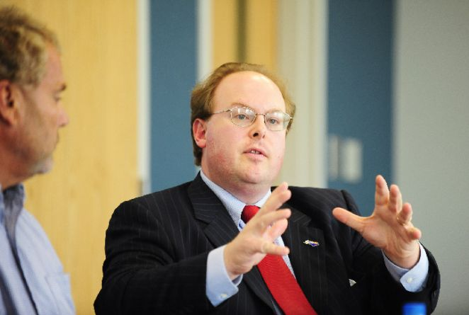
Round 11: NC Government
Question #1:
Wayne Goodwin is the North Carolina Commissioner of what, responsible for regulating and licensing insurance professionals in NC?
5s
5s
Twelve: State Final
Copyright © 2014. All Rights Reserved.
North Carolina Association for Scholastic Activities
Notes:
Five second question slide

Slide 319
Round 11: NC Government
Question #1:
Wayne Goodwin is the North Carolina Commissioner of what, responsible for regulating and licensing insurance professionals in NC?
5s
5s
Twelve: State Final
Copyright © 2014. All Rights Reserved.
North Carolina Association for Scholastic Activities
Notes:
Five second question slide

Slide 320
Round 11: NC Government
Question #2:
The group of popularly elected executive offices in North Carolina is known as the Council of what? This group of ten leaders has regular meetings and is chaired by the Governor.
5s
Twelve: State Final
Copyright © 2014. All Rights Reserved.
North Carolina Association for Scholastic Activities
Notes:
Five second question slide

Slide 321
Round 11: NC Government
Question #2:
The group of popularly elected executive offices in North Carolina is known as the Council of what? This group of ten leaders has regular meetings and is chaired by the Governor.
5s
Twelve: State Final
Copyright © 2014. All Rights Reserved.
North Carolina Association for Scholastic Activities
Notes:
Five second question slide

Slide 322
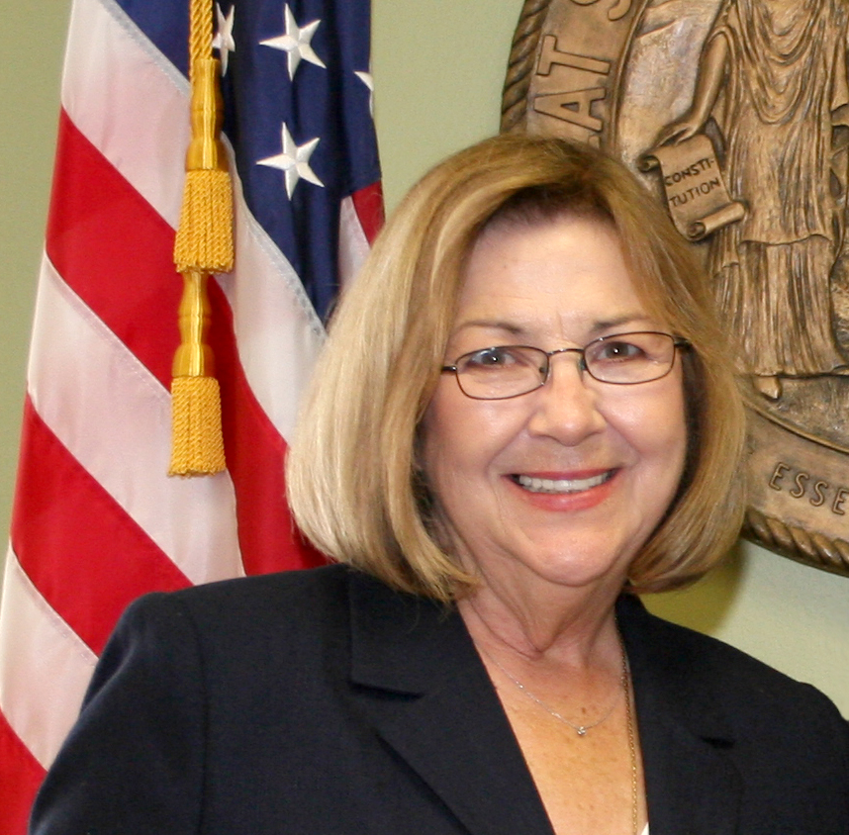
Round 11: NC Government
Question #3:
Who is the Commissioner of Labor, the first NC woman ever elected to this position. She was first elected in 2000.
5s
5s
Twelve: State Final
Copyright © 2014. All Rights Reserved.
North Carolina Association for Scholastic Activities
Notes:
Five second question slide

Slide 323
Round 11: NC Government
Question #3:
Who is the Commissioner of Labor, the first NC woman ever elected to this position. She was first elected in 2000.
5s
5s
Twelve: State Final
Copyright © 2014. All Rights Reserved.
North Carolina Association for Scholastic Activities
Notes:
Five second question slide

Slide 324
Round 11: NC Government
Question #4:
North Carolina state senators and representatives serve terms of what length?
5s
Twelve: State Final
Copyright © 2014. All Rights Reserved.
North Carolina Association for Scholastic Activities
Notes:
Five second question slide

Slide 325
Round 11: NC Government
Question #4:
North Carolina state senators and representatives serve terms of what length?
5s
Twelve: State Final
Copyright © 2014. All Rights Reserved.
North Carolina Association for Scholastic Activities
Notes:
Five second question slide

Slide 326
Round 11: NC Government
Question #5:
What elected official presides over the NC Senate but only votes in case of a tie?
5s
Twelve: State Final
Copyright © 2014. All Rights Reserved.
North Carolina Association for Scholastic Activities
Notes:
Five second question slide

Slide 327
Round 11: NC Government
Question #5:
What elected official presides over the NC Senate but only votes in case of a tie?
5s
Twelve: State Final
Copyright © 2014. All Rights Reserved.
North Carolina Association for Scholastic Activities
Notes:
Five second question slide

Slide 328
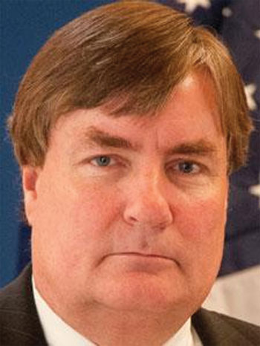
Round 11: NC Government
Question #6:
While officially non-partisan, elections to this state body have become decidedly partisan with millions of out-of-state dollars flowing into races. Sam Ervin IV was recently elected to serve in what body?
5s
Twelve: State Final
Copyright © 2014. All Rights Reserved.
North Carolina Association for Scholastic Activities
Notes:
Five second question slide

Slide 329
Round 11: NC Government
Question #6:
While officially non-partisan, elections to this state body have become decidedly partisan with millions of out-of-state dollars flowing into races. Sam Ervin IV was recently elected to serve in what body?
5s
Twelve: State Final
Copyright © 2014. All Rights Reserved.
North Carolina Association for Scholastic Activities
Notes:
Five second question slide

Slide 330
Round 11: NC Government
Question #7:
What state agency was moved in August 2014 from the Department of Justice under the control of the Attorney General to the Department of Public Safety under Governor McCrory? They assist local law enforcement with criminal investigations.
5s
Twelve: State Final
Copyright © 2014. All Rights Reserved.
North Carolina Association for Scholastic Activities
Notes:
Five second question slide

Slide 331
Round 11: NC Government
Question #7:
What state agency was moved in August 2014 from the Department of Justice under the control of the Attorney General to the Department of Public Safety under Governor McCrory? They assist local law enforcement with criminal investigations.
5s
Twelve: State Final
Copyright © 2014. All Rights Reserved.
North Carolina Association for Scholastic Activities
Notes:
Five second question slide

Slide 332
Round 11: NC Government
Question #8:
The NC Legislature recently changed the law allowing them to hire private attorneys to defend state laws. What state-level position is elected to defend state laws, agencies, and commissions?
5s
Twelve: State Final
Copyright © 2014. All Rights Reserved.
North Carolina Association for Scholastic Activities
Notes:
Five second question slide

Slide 333
Round 11: NC Government
Question #8:
The NC Legislature recently changed the law allowing them to hire private attorneys to defend state laws. What state-level position is elected to defend state laws, agencies, and commissions?
5s
Twelve: State Final
Copyright © 2014. All Rights Reserved.
North Carolina Association for Scholastic Activities
Notes:
Five second question slide

Slide 334
Round 11: NC Government
Question #9:
A PAC is a type of organization that pools campaign contributions in order to influence campaigns, candidates, or elections. PAC’s have been hugely influential in recent NC elections. PAC is an acronym for what?
5s
Twelve: State Final
Copyright © 2014. All Rights Reserved.
North Carolina Association for Scholastic Activities
Notes:
Five second question slide

Slide 335
Round 11: NC Government
Question #9:
A PAC is a type of organization that pools campaign contributions in order to influence campaigns, candidates, or elections. PAC’s have been hugely influential in recent NC elections. PAC is an acronym for what?
5s
Twelve: State Final
Copyright © 2014. All Rights Reserved.
North Carolina Association for Scholastic Activities
Notes:
Five second question slide

Slide 336
Round 11: NC Government
Question #10:
North Carolina’s US Senate race was the most expensive in the country. This race featured which two US Senate candidates from the major parties?
5s
Twelve: State Final
Copyright © 2014. All Rights Reserved.
North Carolina Association for Scholastic Activities
Notes:
Five second question slide

Slide 337
Round 11: NC Government
Question #10:
North Carolina’s US Senate race was the most expensive in the country. This race featured which two US Senate candidates from the major parties?
5s
Twelve: State Final
Copyright © 2014. All Rights Reserved.
North Carolina Association for Scholastic Activities
Notes:
Five second question slide

Slide 338
Round 11: NC Government
Question #11:
In the North Carolina General Assembly, which political party now enjoys a super-majority, allowing them to override any bill vetoed by Governor McCrory?
5s
Twelve: State Final
Copyright © 2014. All Rights Reserved.
North Carolina Association for Scholastic Activities
Notes:
Five second question slide

Slide 339
Round 11: NC Government
Question #11:
In the North Carolina General Assembly, which political party now enjoys a super-majority, allowing them to override any bill vetoed by Governor McCrory?
5s
Twelve: State Final
Copyright © 2014. All Rights Reserved.
North Carolina Association for Scholastic Activities
Notes:
Five second question slide

Slide 340
Round 11: NC Government
Question #12:
In the recent election North Carolina voters approved a change to the state constitution. This change allows defendants in felony cases to waive their right to what kind of trial and have their case decided by a judge?
5s
Twelve: State Final
Copyright © 2014. All Rights Reserved.
North Carolina Association for Scholastic Activities
Notes:
Five second question slide

Slide 341
Round 11: NC Government
Question #12:
In the recent election North Carolina voters approved a change to the state constitution. This change allows defendants in felony cases to waive their right to what kind of trial and have their case decided by a judge?
5s
Twelve: State Final
Copyright © 2014. All Rights Reserved.
North Carolina Association for Scholastic Activities
Notes:
Five second question slide

Slide 342
Round 11: NC Government
Students have 3 minutes to complete their answer sheets.
Twelve: State Final
Copyright © 2014. All Rights Reserved.
North Carolina Association for Scholastic Activities
Notes:
Answer sheet warnings

Slide 343
Round 11: NC Government
Students have 3 minutes to complete their answer sheets.
2 Minutes Remaining
Twelve: State Final
Copyright © 2014. All Rights Reserved.
North Carolina Association for Scholastic Activities
Notes:
Answer sheet warning: 2 minutes

Slide 344
Round 11: NC Government
Students have 3 minutes to complete their answer sheets.
1 Minute Remaining
Twelve: State Final
Copyright © 2014. All Rights Reserved.
North Carolina Association for Scholastic Activities
Notes:
Answer sheet warning: 1 minute

Slide 345
Round 11: NC Government
Students have 3 minutes to complete their answer sheets.
12 Seconds Remaining
Twelve: State Final
Copyright © 2014. All Rights Reserved.
North Carolina Association for Scholastic Activities
Notes:
Answer sheet warning: 12 seconds

Slide 346
Round 11: NC Government
TIME
Pencils Down.
Answer sheets will now be collected.
Twelve: State Final
Copyright © 2014. All Rights Reserved.
North Carolina Association for Scholastic Activities
Notes:
Answer sheet: time

Slide 347
Round 11: NC Government
Answers for Wildcard questions follow on next slide.
Advance once all answer sheets have been collected.
Group C Students may return to their team.
Group D Students may be seated.
Twelve: State Final
Copyright © 2014. All Rights Reserved.
North Carolina Association for Scholastic Activities
Notes:
Prep for answers

Slide 348
Round 11: NC Government
Answers
Insurance
Council of State
Cherie Berry
2 years
Lieutenant Governor
State Supreme Court
SBI or State Bureau of Investigations
Attorney General
Political Action Committee
Thom Tillis, Kay Hagan
Republicans
jury
Twelve: State Final
Copyright © 2014. All Rights Reserved.
North Carolina Association for Scholastic Activities
Notes:
Answers

Slide 349
Round 12: Technology
Group D Students are seated and ready to begin.
Twelve: State Final
Copyright © 2014. All Rights Reserved.
North Carolina Association for Scholastic Activities
Notes:
Seated and ready to go

Slide 350
Round 12: Technology
Question #1:
What process reorganizes the information on a hard drive into contiguous areas, rather than allowing the information to be scattered?
3s
Twelve: State Final
Copyright © 2014. All Rights Reserved.
North Carolina Association for Scholastic Activities
Notes:
Five second question slide

Slide 351
Round 12: Technology
Question #1:
What process reorganizes the information on a hard drive into contiguous areas, rather than allowing the information to be scattered?
3s
Twelve: State Final
Copyright © 2014. All Rights Reserved.
North Carolina Association for Scholastic Activities
Notes:
Five second question slide

Slide 352
Round 12: Technology
Question #2:
The Bessemer process was once used to create what substance made up of iron alloyed with carbon that is used in construction?
3s
Twelve: State Final
Copyright © 2014. All Rights Reserved.
North Carolina Association for Scholastic Activities
Notes:
Five second question slide

Slide 353
Round 12: Technology
Question #2:
The Bessemer process was once used to create what substance made up of iron alloyed with carbon that is used in construction?
3s
Twelve: State Final
Copyright © 2014. All Rights Reserved.
North Carolina Association for Scholastic Activities
Notes:
Five second question slide

Slide 354
Round 12: Technology
Question #3:
What type of computer software responds to the requests of clients on a computer network? This term also describes computers dedicated to responding to clients on a network.
3s
Twelve: State Final
Copyright © 2014. All Rights Reserved.
North Carolina Association for Scholastic Activities
Notes:
Five second question slide

Slide 355
Round 12: Technology
Question #3:
What type of computer software responds to the requests of clients on a computer network? This term also describes computers dedicated to responding to clients on a network.
3s
Twelve: State Final
Copyright © 2014. All Rights Reserved.
North Carolina Association for Scholastic Activities
Notes:
Five second question slide

Slide 356
Round 12: Technology
Question #4:
Intel and AMD are major manufacturers of what computer component that carries out a computer’s basic operations, such as arithmetic and input/output operations?
3s
Twelve: State Final
Copyright © 2014. All Rights Reserved.
North Carolina Association for Scholastic Activities
Notes:
Five second question slide

Slide 357
Round 12: Technology
Question #4:
Intel and AMD are major manufacturers of what computer component that carries out a computer’s basic operations, such as arithmetic and input/output operations?
3s
Twelve: State Final
Copyright © 2014. All Rights Reserved.
North Carolina Association for Scholastic Activities
Notes:
Five second question slide

Slide 358
Round 12: Technology
Question #5:
What devices transfer electrical power from one circuit to another, changing the voltage along the way?
3s
Twelve: State Final
Copyright © 2014. All Rights Reserved.
North Carolina Association for Scholastic Activities
Notes:
Five second question slide

Slide 359
Round 12: Technology
Question #5:
What devices transfer electrical power from one circuit to another, changing the voltage along the way?
3s
Twelve: State Final
Copyright © 2014. All Rights Reserved.
North Carolina Association for Scholastic Activities
Notes:
Three second question slide

Slide 360
Round 12: Technology
Question #6:
What term refers to a type of computing in which data storage, applications, and other resources are shared on the Internet? It is named for a commonly used way of portraying this type of computing.
3s
Twelve: State Final
Copyright © 2014. All Rights Reserved.
North Carolina Association for Scholastic Activities
Notes:
Five second question slide

Slide 361
Round 12: Technology
Question #6:
What term refers to a type of computing in which data storage, applications, and other resources are shared on the Internet? It is named for a commonly used way of portraying this type of computing.
3s
Twelve: State Final
Copyright © 2014. All Rights Reserved.
North Carolina Association for Scholastic Activities
Notes:
Five second question slide

Slide 362
Round 12: Technology
Question #7:
What video sharing website owned by Google is the third most popular site in the world?
3s
Twelve: State Final
Copyright © 2014. All Rights Reserved.
North Carolina Association for Scholastic Activities
Notes:
Five second question slide

Slide 363
Round 12: Technology
Question #7:
What video sharing website owned by Google is the third most popular site in the world?
3s
Twelve: State Final
Copyright © 2014. All Rights Reserved.
North Carolina Association for Scholastic Activities
Notes:
Five second question slide

Slide 364
Round 12: Technology
Question #8:
What field of engineering focuses on the design and construction of machine systems and tools?
3s
Twelve: State Final
Copyright © 2014. All Rights Reserved.
North Carolina Association for Scholastic Activities
Notes:
Five second question slide

Slide 365
Round 12: Technology
Question #8:
What field of engineering focuses on the design and construction of machine systems and tools?
3s
Twelve: State Final
Copyright © 2014. All Rights Reserved.
North Carolina Association for Scholastic Activities
Notes:
Five second question slide

Slide 366
Round 12: Technology
Question #9:
What Microsoft search engine powers searches on Yahoo.com and is the second most popular search engine in the United States?
3s
Twelve: State Final
Copyright © 2014. All Rights Reserved.
North Carolina Association for Scholastic Activities
Notes:
Five second question slide

Slide 367
Round 12: Technology
Question #9:
What Microsoft search engine powers searches on Yahoo.com and is the second most popular search engine in the United States?
3s
Twelve: State Final
Copyright © 2014. All Rights Reserved.
North Carolina Association for Scholastic Activities
Notes:
Five second question slide

Slide 368
Round 12: Technology
Question #10:
What business initially created as part of eBay allows online money transfers? Most shoppers on eBay use this site to make their purchases.
3s
Twelve: State Final
Copyright © 2014. All Rights Reserved.
North Carolina Association for Scholastic Activities
Notes:
Five second question slide

Slide 369
Round 12: Technology
Question #10:
What business initially created as part of eBay allows online money transfers? Most shoppers on eBay use this site to make their purchases.
3s
Twelve: State Final
Copyright © 2014. All Rights Reserved.
North Carolina Association for Scholastic Activities
Notes:
Five second question slide

Slide 370
Round 12: Technology
Question #11:
In 2005, Google purchased the developer of what most popular smartphone operating system in the world?
3s
Twelve: State Final
Copyright © 2014. All Rights Reserved.
North Carolina Association for Scholastic Activities
Notes:
Five second question slide

Slide 371
Round 12: Technology
Question #11:
In 2005, Google purchased the developer of what most popular smartphone operating system in the world?
3s
Twelve: State Final
Copyright © 2014. All Rights Reserved.
North Carolina Association for Scholastic Activities
Notes:
Five second question slide

Slide 372
Round 12: Technology
Question #12:
Ethylene glycol is often used in what substance used to keep the coolant of cars from solidifying in cold temperatures?
3s
Twelve: State Final
Copyright © 2014. All Rights Reserved.
North Carolina Association for Scholastic Activities
Notes:
Five second question slide

Slide 373
Round 12: Technology
Question #12:
Ethylene glycol is often used in what substance used to keep the coolant of cars from solidifying in cold temperatures?
3s
Twelve: State Final
Copyright © 2014. All Rights Reserved.
North Carolina Association for Scholastic Activities
Notes:
Five second question slide

Slide 374
Round 12: Technology
Students have 3 minutes to complete their answer sheets.
Twelve: State Final
Copyright © 2014. All Rights Reserved.
North Carolina Association for Scholastic Activities
Notes:
Answer sheet warnings

Slide 375
Round 12: Technology
Students have 3 minutes to complete their answer sheets.
2 Minutes Remaining
Twelve: State Final
Copyright © 2014. All Rights Reserved.
North Carolina Association for Scholastic Activities
Notes:
Answer sheet warning: 2 minutes

Slide 376
Round 12: Technology
Students have 3 minutes to complete their answer sheets.
1 Minute Remaining
Twelve: State Final
Copyright © 2014. All Rights Reserved.
North Carolina Association for Scholastic Activities
Notes:
Answer sheet warning: 1 minute

Slide 377
Round 12: Technology
Students have 3 minutes to complete their answer sheets.
12 Seconds Remaining
Twelve: State Final
Copyright © 2014. All Rights Reserved.
North Carolina Association for Scholastic Activities
Notes:
Answer sheet warning: 12 seconds

Slide 378
Round 12: Technology
TIME
Pencils Down.
Answer sheets will now be collected.
Twelve: State Final
Copyright © 2014. All Rights Reserved.
North Carolina Association for Scholastic Activities
Notes:
Answer sheet: time

Slide 379
Round 12: Technology
Answers for Technology questions follow on next slide.
Advance once all answer sheets have been collected.
Group D Students may return to their team.
Twelve: State Final
Copyright © 2014. All Rights Reserved.
North Carolina Association for Scholastic Activities
Notes:
Prep for answers

Slide 380
Round 12: Technology
Answers
Defragmentation
Steel
Server
CPU [or Central Procession Unit]
Transformers
Cloud Computing
Youtube
Mechanical Engineering
Bing
Paypal.com
Google Android
Antifreeze
Twelve: State Final
Copyright © 2014. All Rights Reserved.
North Carolina Association for Scholastic Activities
Notes:
Answers

Slide 381
End of Session
Scores will be posted as soon as they are ready.
Twelve: State Final
Copyright © 2014. All Rights Reserved.
North Carolina Association for Scholastic Activities

